Slide 1


Budget Credibility and INFFs
Orria Goni Delzangles, Chief Public Finance and Local Governance, UNICEF Social Policy, Programme Group
June 12th, Addis Ababa
© UNICEF/UNI134450/Sokol

Slide 2

What is Budget Credibility?
The ability of governments to meet expenditure and revenue targets set out in their budgets accurately and consistently
2 | Budget Credibility and INFFs
© UNICEF/UN0642760/Willocq

Slide 3
Why does budget credibility matter?
More than 2/3 of governments struggle to maintain the planned composition of
their expenditure throughout the fiscal year
Social sector spending tends to be deprioritized
INFFs
Stronger Public Finance
SDGs
Mutually Reinforcing
Credible Budgets
3 | Budget Credibility and INFFs

Slide 4
Impact of low credibility on delivery of the SDGs
Deviations in | Over- collection/overspending | Under- collection/spending
Revenue | Lost opportunity to advance priorities | Inability to spend on priorities
Expenditure | Inefficient and wasteful spending Lack of effective budgetary controls Increased deficits and potential debt distress | Hamper delivery of crucial services Under performance of service delivery and development targets Execution delays and increase in project costs Chronic underfunding and de-prioritization
4 | Budget Credibility and INFFs

Slide 5
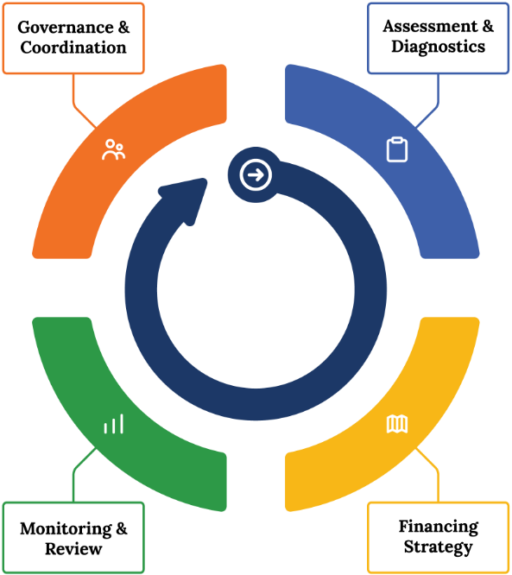
Budget Credibility & the INFF Building Blocks
Include stakeholders relevant to PFM and SDG Service Delivery
Initiate problem-solving dialogues on identified bottlenecks across relevant stakeholders
Track agreed strategic measures and reforms
Evaluate precision of activity cost estimates
Assess budget deviations at aggregate and sector level
Identify risks and binding constraints contributing to low budget credibility
Use Budget Credibility as a metric in annual monitoring and oversight
Enhance planning, budgeting, and monitoring systems and connect to outcomes
Identify public finance reforms that address root causes of budget credibility issues
Improve budget credibility to close gaps with public and private finance
5 | Budget Credibility and INFFs

Slide 6

UNICEF-IBP Budget Credibility collaboration
Country-level Research and Advocacy
Cross-Cutting Themes and Findings
Challenges in Timely Fund Disbursement: Delays in fund release were a common issue, affecting the execution of immunization programs.
Planning and Budgeting Deficiencies: Emphasized across studies, improving the accuracy and efficiency of planning and budgeting processes was a key recommendation, including at subnational level.
Data and System Challenges: Issues with data reliability and financial management systems for both financial and performance data, impacting budget tracking and execution analysis.
Capacity Building: Recurrent theme across studies, with recommendations for targeted capacity building for national/subnational government officials and local health offices to address planning, budgeting, and execution challenges.
Transparency and Accountability: Ongoing challenges in many contexts, however growing government engagement to enhance fiscal transparency and accountability across countries, with initiatives like open budget portals and regular performance reviews.
Malawi: Using disaggregated data analysis to identify and understand budget credibility challenges
Nepal: Health sector budget analysis to strengthen PFM systems at the subnational level
Namibia: Strengthening health procurement to improve the impact of health investments
Ghana: Budget tracking to enhance credibility for social programmes
Nigeria: Contribution of subnational governments and civil society to increase the reliability of health budgets
Kenya: Enhancing budget credibility through a multi-pronged approach to strengthen PFM systems and social accountability processes

Slide 7

Thank you!
Asante Sana!
አመሰግናለሁ!
O ṣeun!
Merci!
Obrigada!
© UNICEF/UN043869/Lister

Slide 8
Key Resources
Budget Credibility and Integrated National Financing Frameworks (2024)
Integrated national financing frameworks
Integrated National Financing Frameworks (website) – INFF Technical Guidance Document
Integrated National Financing Frameworks (website) – Guidance material & Country experiences per building block
IATF (2019 – 2023), Financing for Sustainable Development Reports
Budget credibility assessment tools
Public Expenditure and Financial Accountability (PEFA) (2016), Framework for assessing public financial management
PEFA (2018), PEFA Handbook Volume II: PEFA Assessment fieldguide, Second Edition
PEFA Resources (website)
IMF (2019), Fiscal Transparency code
UNICEF (2021), The UNICEF Public Finance Toolkit: A resource guide for selecting, adapting and applying public financial analysis tools
World Bank (website), BOOST Open Budget Portal
Research papers and guides on Budget credibility and Public financial management
International Budget Partnerships (IBP) (2019), Budget Credibility Across Countries: How Deviations are Affecting Spending on Social Priorities
IBP (2022), Connecting Budget Credibility and the Sustainable Development Goals: Results from 13 Country Investigations
Other IBP resources (website) on budget credibility
financial management challenges in the health sector: A resource guide for a problem-driven approach for UNICEF country offices
United Nations Department of Economic and Social Affairs (UNDESA), IBP (2023), Strengthening Budget Credibility through external audits, A handbook for auditors.
Notes:
To conclude this presentation please find here a list of key resources that provide further insights into Integrated National Financing Frameworks, Budget credibility assessment tools and relevant research papers.
The INFF Technical Guidance Document (which is linked to the first reference) provides further insights into existing literature and relevant methodologies.

