Slide 1



Connecting the dots: Public finance within INFFs in Sub-Saharan Africa
Ankun Liu, SDG Finance Specialist
UNDP Africa Sustainable Finance Hub

Slide 2
Contents
1
State of INFFs in Sub-Saharan Africa
2
UNDP’s integrated public finance approach
3
Public finance reforms in INFFs
4
Further information

Slide 3
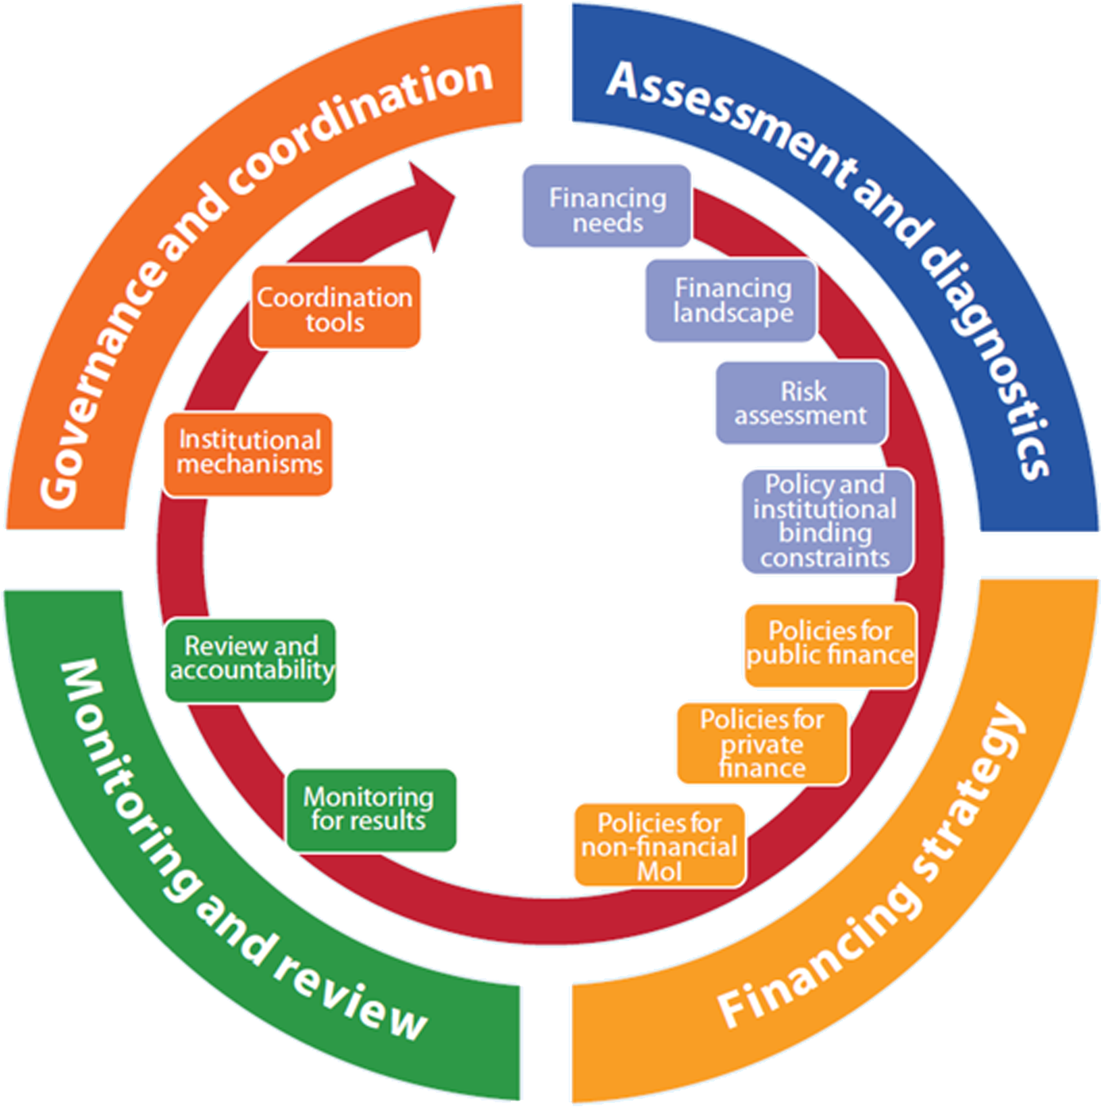
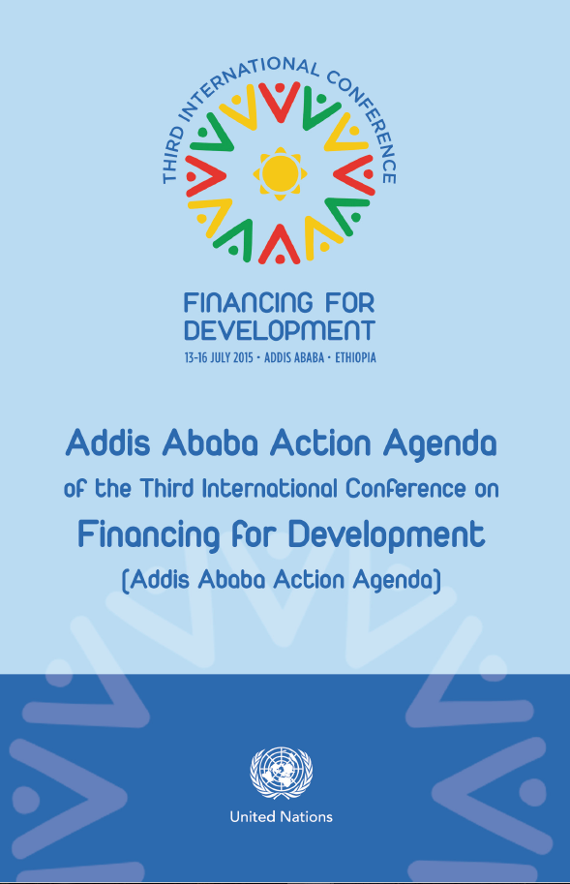
Addis Ababa Action Agenda
Member states introduced INFFs to address the need for comprehensive and coordinated approaches to financing their national priorities:
“cohesive, nationally owned sustainable development strategies, supported by integrated national financing frameworks, will be at the heart of our efforts”

Slide 4
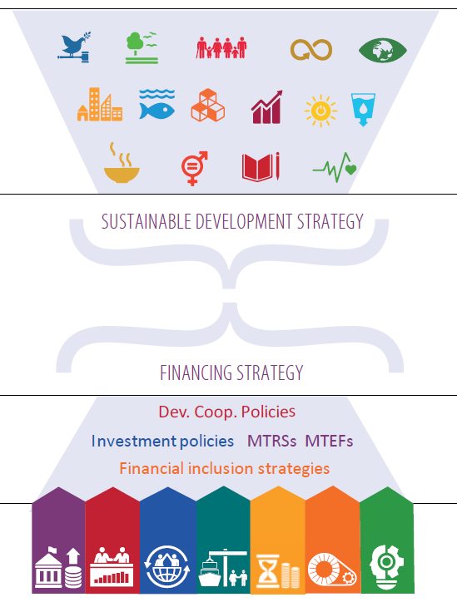
Integrated National Financing Framework (INFF)
National priorities and SDGs
Key financial flows and mechanisms
across public and private finance
Government revenue (tax and non-tax)
Public expenditure
Public debt (loans, sovereign bonds)
Fiscal decentralization (fiscal transfer, local revenue, and expenditure)
ODA
South-South cooperation
Public-private partnerships
Domestic private investment
Credit to the private sector
Capital markets (equity market & bond market)
Institutional investment (pensions, insurance, PE/VC, REITs, etc.)
Islamic finance
Foreign direct investment
Remittances and diaspora finance
Integrating plan and financing policies
Integrating public and private financing
Integration and collaboration across public and private actors
Key financing and related policies
Sources of finance and other means of implementation
Notes:
Integrated national financing frameworks (INFFs) provide a framework for financing national sustainable development priorities and the SDGs through a higher level of integration between financing and national planning, across public and private financing policies, and between public and private actors.

Slide 5
Financing Landscape in Sub-Saharan Africa
Public debt
Macro challenges:
SDG Financing Gap: $350 billion SDGs-related annual investment is needed in Africa and the demand keeps rising.
Economic growth prospect remains relatively weak, from an average of 3.3% in 2023 to 3.5% in 2024.
Monetary tightening and inflation: Most central banks were in a monetary tightening phase in 2023 to curb high inflation pressures and stabilize exchange rates.
Debt sustainability challenges continue: 18 African countries had a debt/GDP ratio of over 70% in 2023, facing debt distress. Debt servicing (% of GDP) has increased rapidly, squeezing public expenditure allocation.
High borrowing costs: about 4 times higher than those for developed countries, due to low credit ratings and tightening monetary climate.
Fiscal positions remained tight for many countries in the context of high public debt and a low domestic revenue base.
Climate finance to Africa continues to fall far short of its needs, e.g., only 2% of global clean energy finance flows into Africa.
Geopolitical instability will continue to adversely impact several subregions in Africa, especially the Sahel region. ‘
Remittances
ODA
Climate finance
FDI
Credit 2 private sector
Revenue
Data source: IMF, WB, & CPI

Slide 6
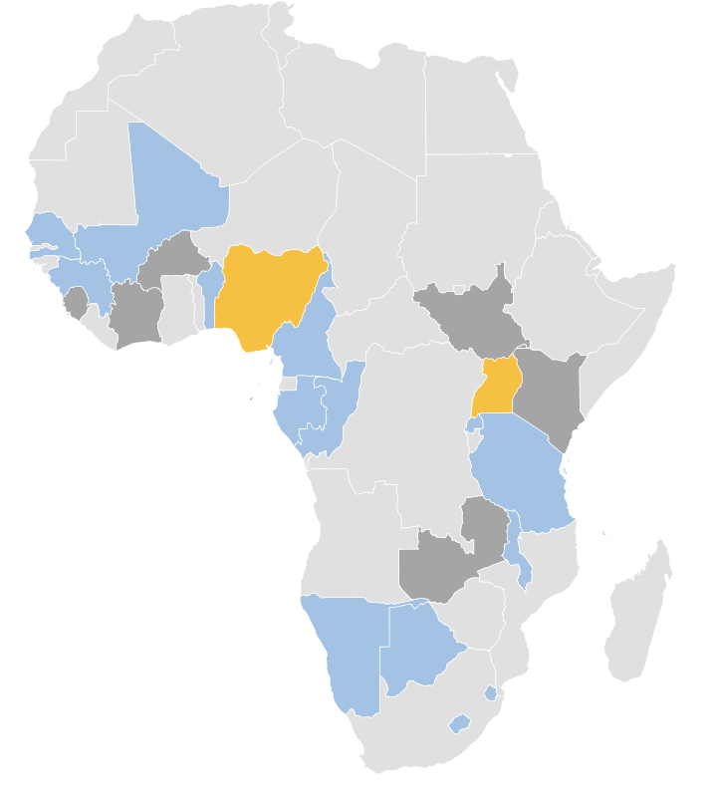


25
Integrated financing strategies across Sub-Saharan Africa in 2024
2 Launched
Nigeria
Uganda
7 in Pipeline
Burkina Faso
Cote d’Ivoire
Kenya
Sao Tome and Principe
Sierra Leone
South Sudan
Zambia
16 Drafted
Benin
Botswana
Cameroon
Comoros
Eswatini Ethiopia
Gabon
Guinea
Lesotho
Malawi
Mali
Namibia
R. Congo
Rwanda
Senegal
Tanzania

Slide 7
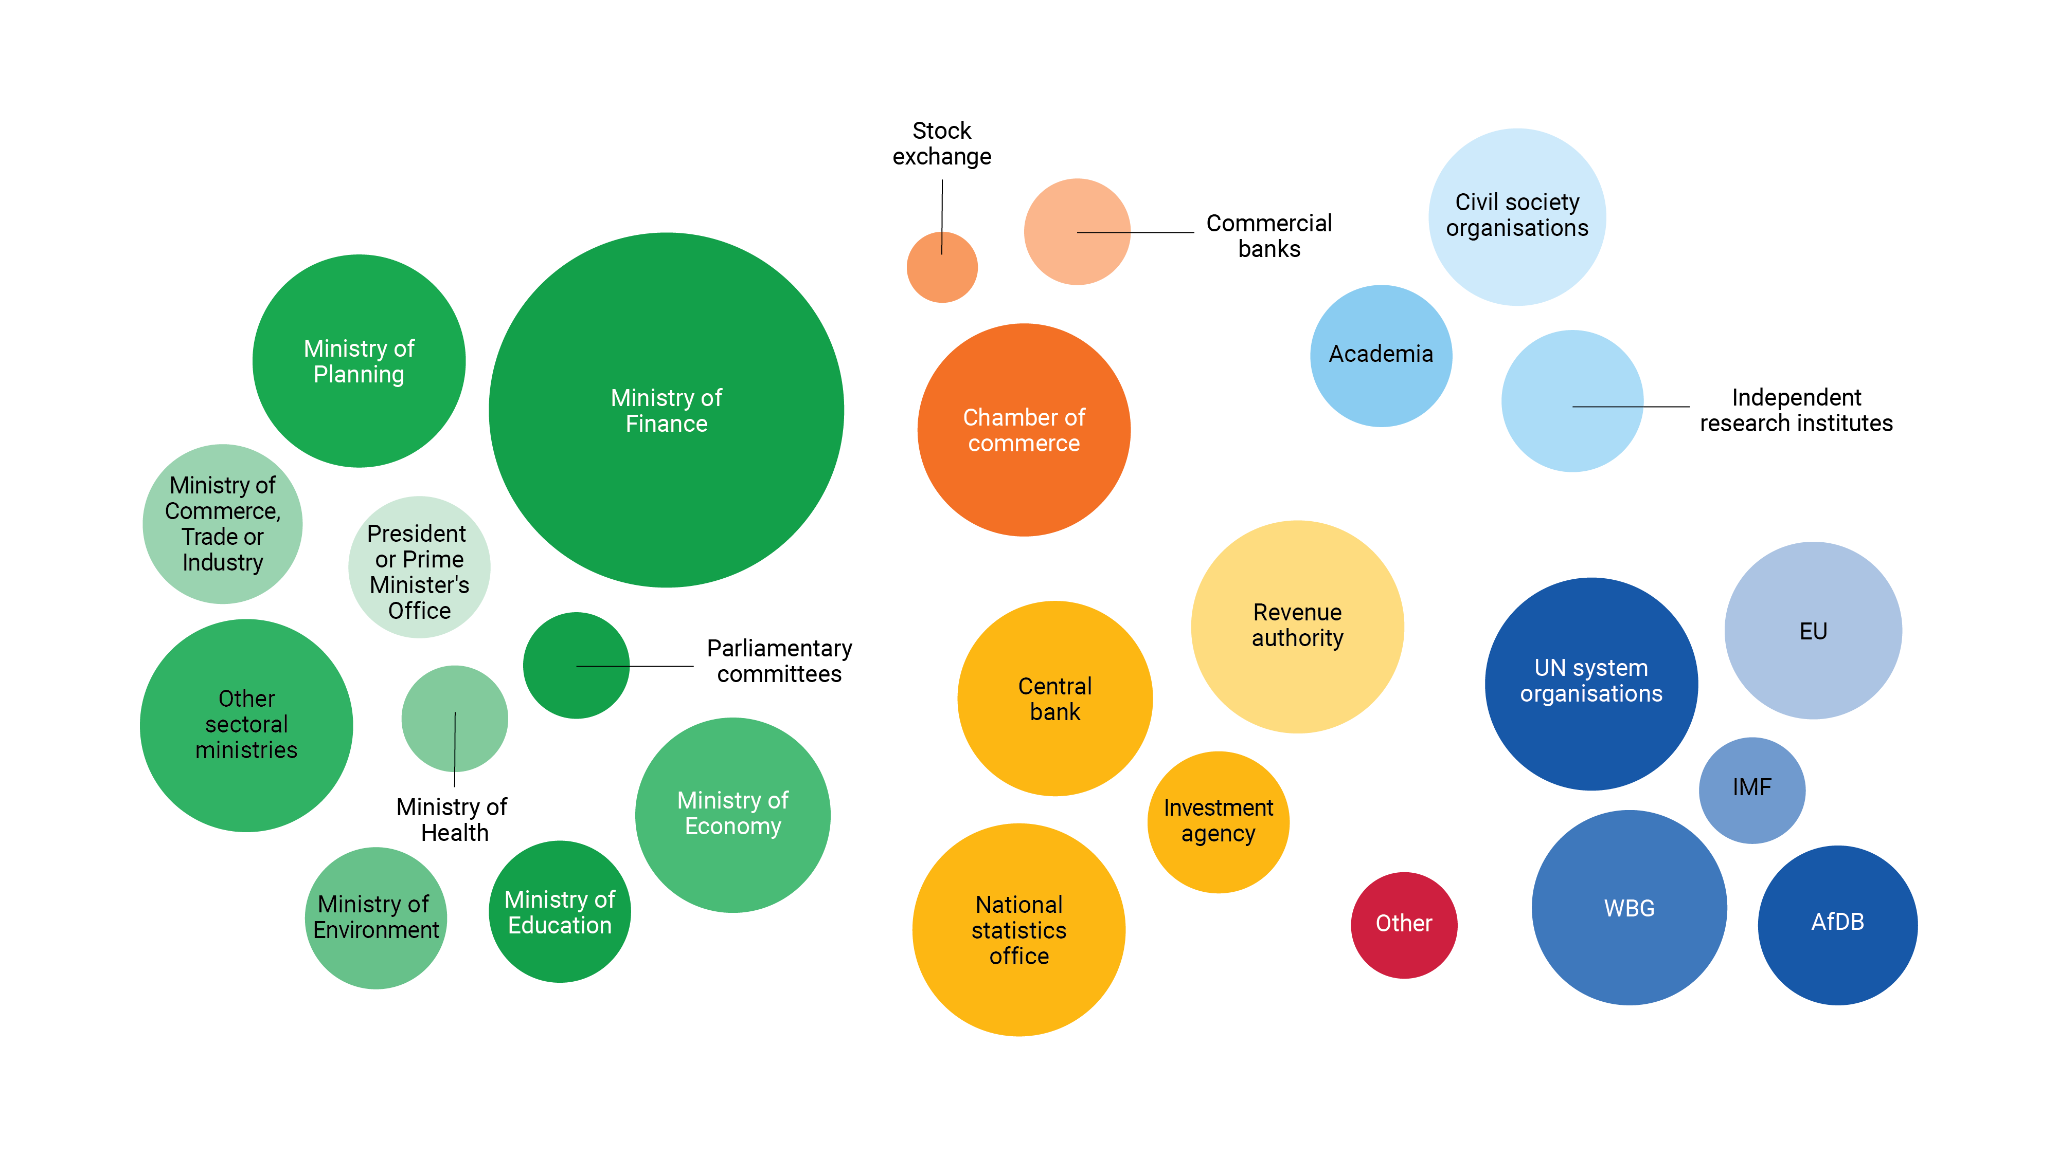
Key INFF Stakeholders in sub-Saharan Africa

Slide 8
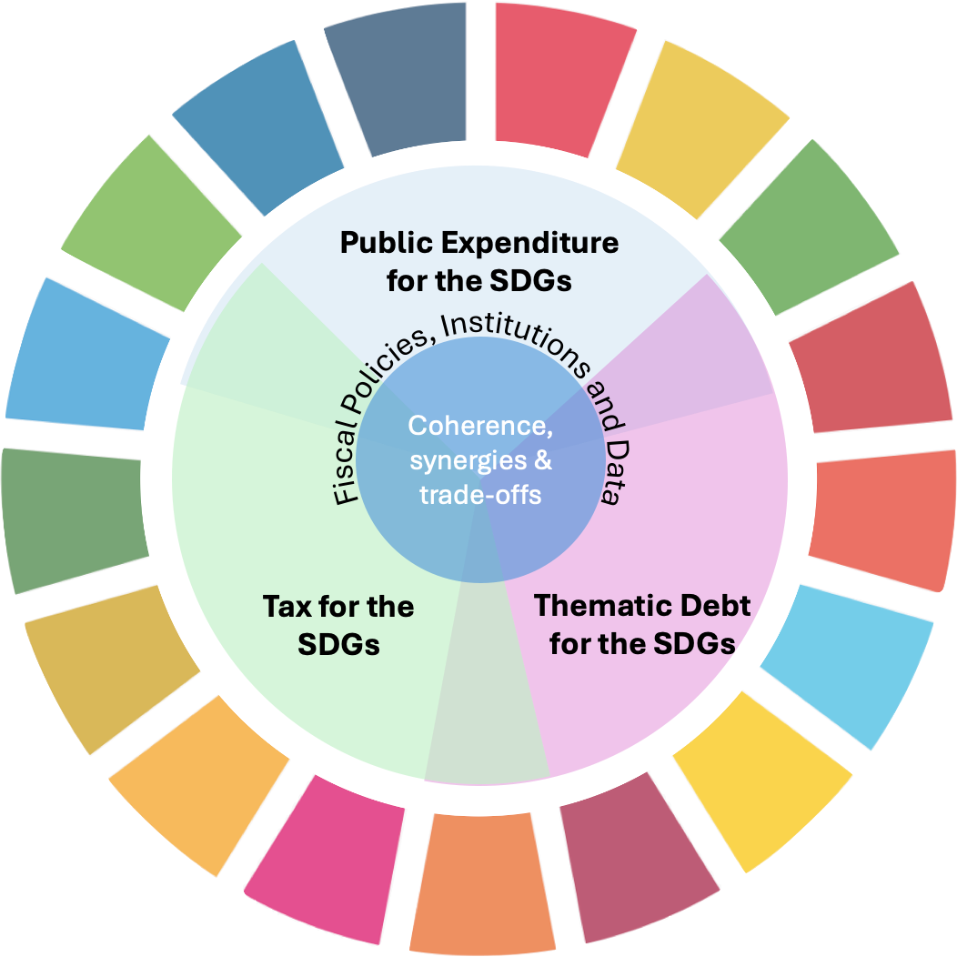
UNDP’s Integrated Public Finance for the SDGs
Key elements:
Fiscal policy decisions - tax, public expenditure & thematic debt undertaken coherently
SDGs lens in fiscal policy decisions
Strengthened governance and data
Coherent and synergetic decisions, balancing trade-offs, for impact:
Fiscal policy for poverty reduction
Fiscal policy for equality/inclusiveness
Fiscal policy for nature & climate

Slide 9


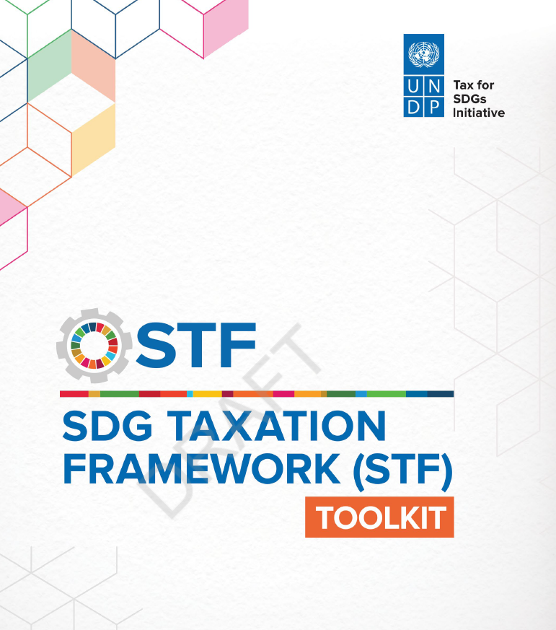
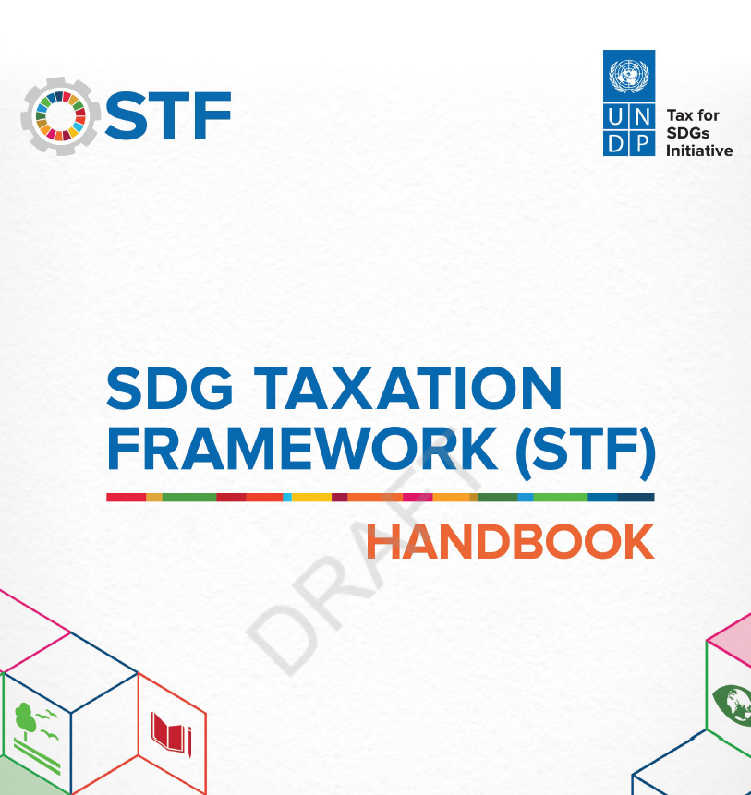

Tax for SDGs
Illicit financial flows
SDG-aligned tax policy
Tackle aggressive tax avoidance, tax evasion and illicit financing flows
Align tax and fiscal policy with the SDGs
Tax Inspectors Without Borders (TIWB) programs
in 33 countries
(tax audits in extractives, finance, telecom, crime)
SDG Taxation Frameworks
15 countries with Country Engagement Plans
Cumulative increase in additional tax collection in Africa through TIWB from 2015 ($ million)

Slide 10
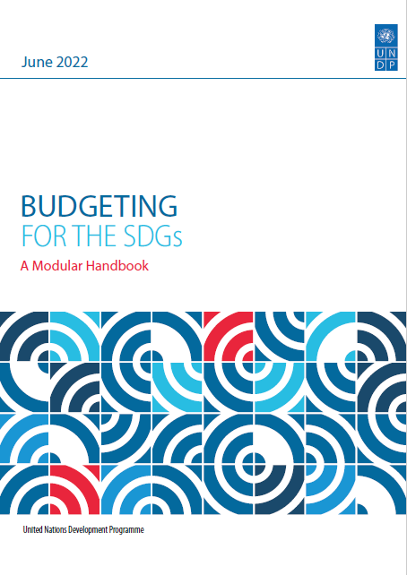
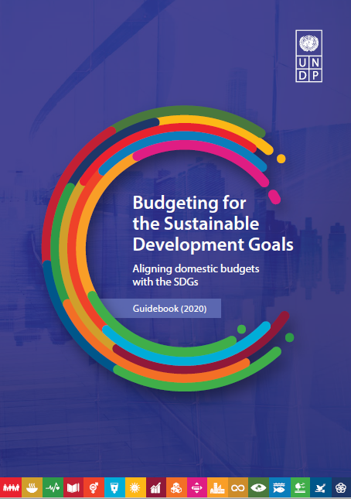
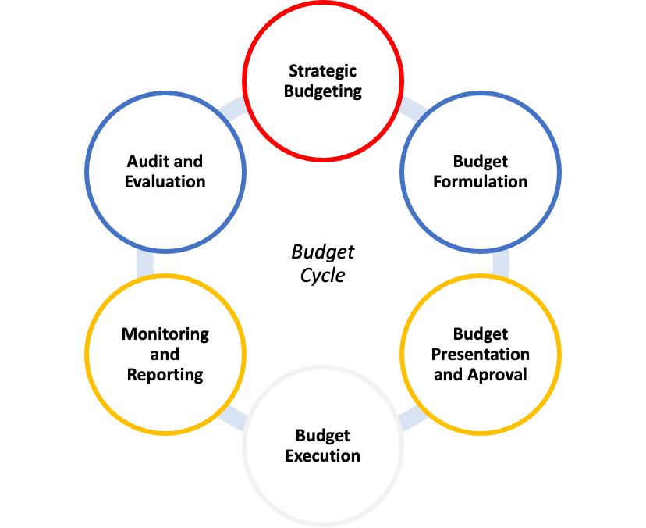
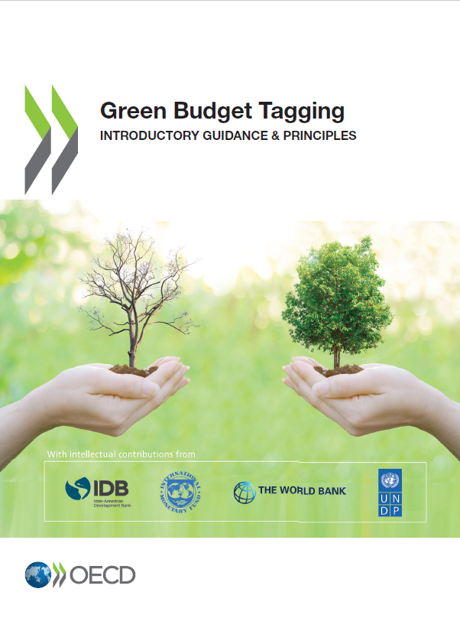
Public expenditure for SDGs
SDG aligned MTBFs
SDG Financing Frameworks
SDG focus:
Expenditure Reviews
Evaluations
Audits
SDG aligned Programme budgeting
Budget Call Circular and Budget Bids & review include SDGs
SDG Budget Coding and Tagging
Budget books present SDG budgets and policies
Parliaments debate SDG budget & policies
SDG Budget credibility (PFM bottlenecks)
Green Procurements

Slide 11
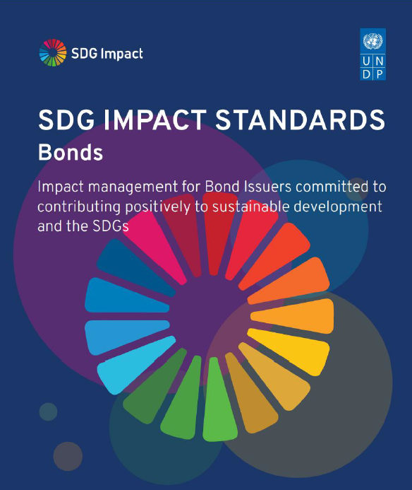
Debt for SDGs
Notes:
UNDP can provide advisory support and technical assistance on the quantitative analysis & feasibility assessment of the issuance of thematic bonds, assisting in the various phases of the building up and implementation of a potential bond issuance targeted to SDG achievements.
In particular:
Development of the SDG/thematic bond framework
Identification of eligible budget items
Post-issuance Monitor and reporting

Slide 12
Financing priorities and reforms for implementation
Notes:
Financing reforms to implement within financing strategies across tax, public spending, sustainable debt, development cooperation.

Slide 13
Emerging outcomes
NIGERIA
CABO VERDE
$100m INFF Fund (2024, 10yr, govt, DP, others)
$30m Additional revenue collection via tax auditing capacity improv.
Removal of fuel subsidies $6-9 B to invest savings in infrastructure dev.
>$30m sustainable bonds issued on its sustainable financing platform (Blu-X)
Supporting blue infrastructure, SMEs, social investment
Development of blue taxonomy
BENIN
GHANA
€500m SDG Eurobond to finance social and environmental projects.
Built on the previous SDG costing and aligned with pillars of 2018–2025 NDP and SDGs.
Transparent impact reporting
5 assemblies adopted Integrated Assembly Financing Frameworks
To diversify local revenue streams, incl. own-sourced revenues, central government transfer, development partners and others.
84 local authorities trained on local revenue mobilization.

Slide 14

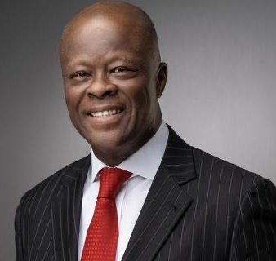
I'm very happy that Nigeria has seized the opportunity to be the first to launch the financing strategy.
INFF is a tool for us to align medium term expenditure with medium term revenue, and technical improvements.
H.E. Mr. Adebayo Olawale Edun
Honorable Minister of Finance and
Coordinating Minister of the Economy

Slide 15

Looking ahead in INFFs
COUNTRY-LEVEL PRIORITIES:
Finalize financing strategies and establish monitoring systems for implementation.
Scale implementation of the reforms prioritized in financing strategies.
Deepen climate, nature, gender equality integration; INFFs for both NDPs and NDCs.
Integrated local financing frameworks: meeting demand from subnational governments.
Invite IFIs, DPs and others to align engagement with national financing strategies.

Slide 16
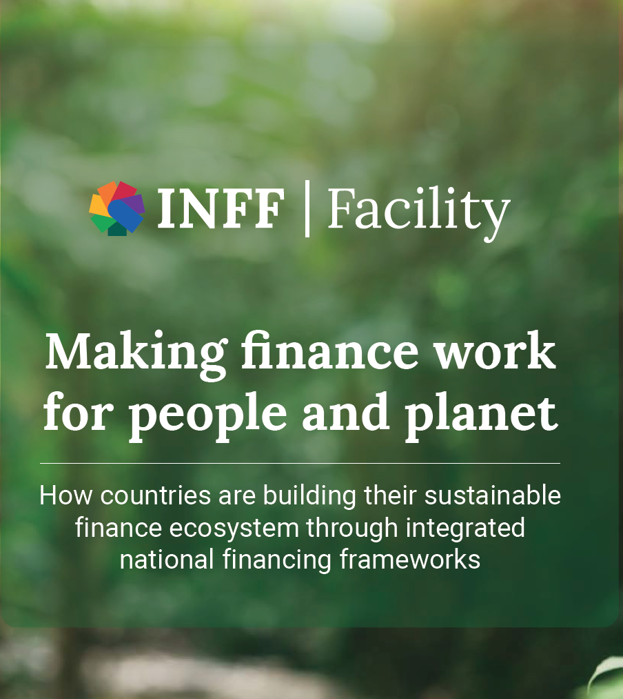
Resources and contacts
01
02
Key INFF publications
Contact us for more information
Global Team
Tim Strawson
SDG Finance Advisor, UNDP
tim.strawson@undp.org
Regional Team
Ankun Liu
SDG Finance & South-South Cooperation Specialist, UNDP
ankun.liu@undp.org
Ana-Maria Beldiga
SDG Finance Consultant
ana-maria.beldiga@undp.org
→ The latest Global INFF report, States of INFF and dashboard
Progress and data from the latest global survey
→ The latest INFF stocktake
An overview of INFF progress since the G20 endorsement in 2022
→ Global guidance
A step-by-step approach, bringing together tested methodologies and tools
→ INFF e-learning course
Our course for beginners and more advanced learners

Slide 17



Thank you.
For more information, visit www.inff.org
@INFFplatform

