Slide 1
Title
Regional Workshop on Integrated National Financing Frameworks 2024
Public Finance for Sustainable Development in Africa by
SABITI Fred
Rwanda Ministry of Finance and Economic Planning (MINECOFIN)
Addis Ababa, Ethiopia 12-13 June 2024

Slide 2
Presentation outline
Introduction
Current Benchmarks
Rwanda Climate Budget Tagging (CBT) process
National Technical committee roles/responsibilities
Way-forward

Slide 3
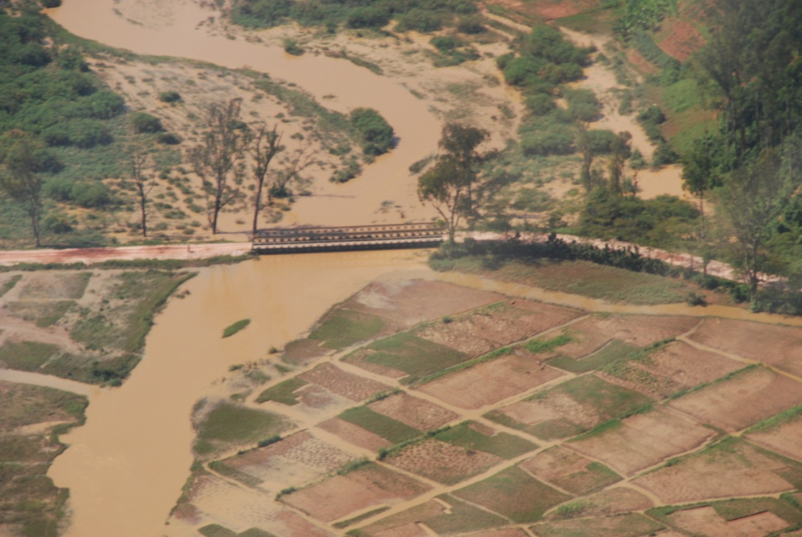
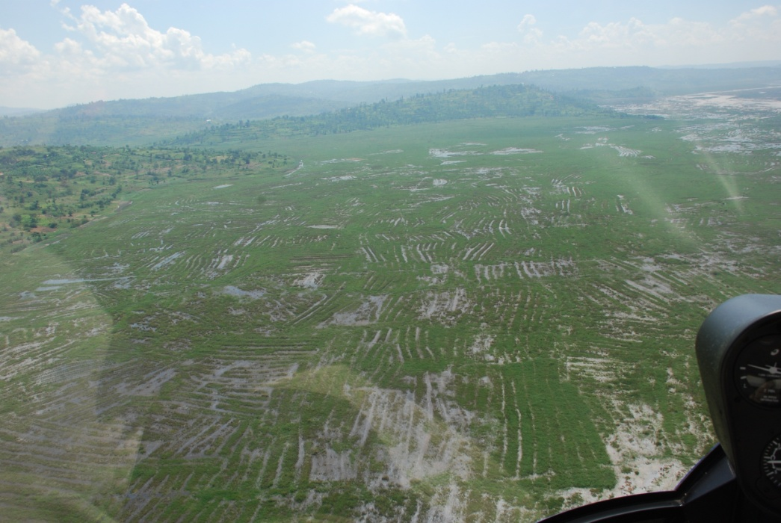
Introduction
Current Benchmarks
Rwanda is experiencing the impacts of climate change: weather related disasters including droughts, floods, landslides-Expected to lose about 5%of our GDP by 2030.
Rwanda is Party to the Paris Agreement and submitted its updated NDC in May 2020.
Article 13 of the Paris Agreement requires the establishment of an Enhanced Transparency Framework (ETF), requiring to account for NDC related financial flows, alongside other reporting requirement for National Communications (NCs) and Biennial Transparency Reports (BTR).

Slide 4
Current tracking of climate financial flows
Rwanda invested 4.9% of the annual budget in Env & Ecc (2020/2021)
Env & cc have been Tracked through:
Env &CC annual budget Assessment
Env & cc monitoring statement
Public Expenditure Review for Environment and Climate Change
Associated Challenges
  Time consuming
  Uncoordinated information sources
  Duplication of data

Slide 5

Existing tools
1. Env & CC Checklist
2. Env & CC Monitoring statement
3. Climate Budget Tagging (CBT)

Slide 6
  Environment and Climate Change Monitoring Statement Format
  Institution: Ministry/District
Program: Name of a Programme
Subprogram: Name of the Sub-Programme
Environment, Natural Resources and Climate Situational Analysis* | Output | Activity | Indicator | Allocated Budget

Slide 7
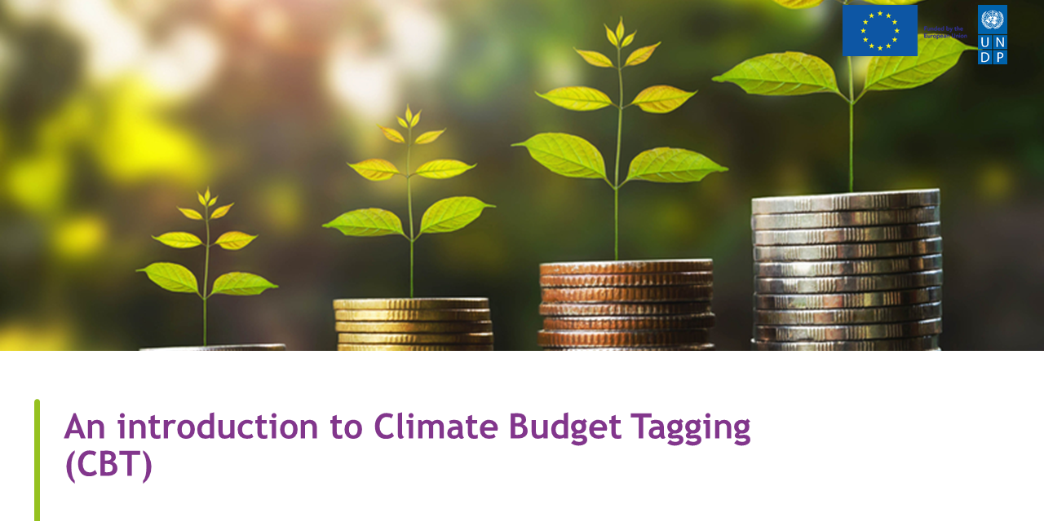
Background to the CBT
On April 13, 2022, the Executive Board of the IMF approved the establishment of the Resilience and Sustainability Trust (RST).
The RST’s central objective is to provide affordable long-term financing to support countries as they tackle two longer-term structural challenges— including climate change.
Rwanda is one of the 143 countries that are RST-eligible and was selected among the pilot countries.
To qualify for the program, Rwanda was tasked to propose a set of high-quality reform measures (RMs) relevant to the purpose of RST, specifically consistent with country diagnostics developed by the WB and IMF, in particular, CCDRs (Country climate development report) and CMAPs (Climate Macroeconomic Assessment Program). One of these reforms was to develop a CBT
Background
On April 13, 2022, the Executive Board of the IMF approved the establishment of the Resilience and Sustainability Trust (RST).
The RST’s central objective is to provide affordable long-term financing to support countries as they tackle two longer-term structural challenges— including climate change and pandemic preparedness—that entail significant macroeconomic risks and where policy solutions have a strong global public good nature.
Rwanda is one of the 143 countries that are RST-eligible and was selected among the pilot countries.
To qualify for the program, Rwanda was tasked to propose a set of high-quality reform measures (RMs) relevant to the purpose of RST, specifically consistent with country diagnostics developed by the WB and IMF, in particular, CCDRs and CMAPs.

Slide 8
Climate Budget Tagging-what is it?
Tagging is the process of assigning a mark or a sign to a given intervention for ease of tracking and identification of these interventions in order to access them at the time they are needed especially for reporting purposes (NDC/UNFCCC etc).
Climate Budget Tagging (CBT) is a tool for monitoring and tracking of climate-related expenditures in the national budget system.
It provides comprehensive data on climate change relevant spending, enabling government to make informed decisions and prioritize climate investments.
CBT enables scrutiny on Government’s and donors’ spending on tackling climate change issues strengthening accountability and transparency.
CBT increases the prioritisation of programmes that deliver mitigation or adaptation by providing information in budget processes.

Slide 9
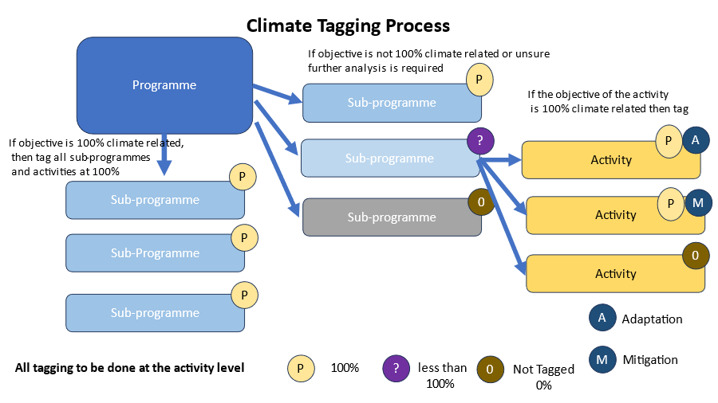
Rwanda tagging process

Slide 10

Tagging in the System
In the IFMIS, data entry will be done under 3 categories:
Adaptation
Mitigation
Both: Adaptation & Mitigation

Slide 11


National Technical committee
Purpose: To oversee the entire CBT reform initiative Lead: MINECON/ Directorate of National Budget Composition: Technical committee Members include: MINECOFIN: Budget Office, Planning, Monitoring & Evaluation Ministry of Environment: Environment & Climate change policy specialist Ministry of Agriculture: Planning Specialist Ministry of Infrastructure: Planning Specialist Rwanda Environment Management Authority: Environment & Climate change mainstreaming officer & Director of environment advocacy & MEAs Unit. Local Administrative Entities Development Agency (LODA): Program manager-village model project.

Slide 12
Mandate
The mandate of the technical team which will be established at the national level will be: To support the CBT implementation process by defining the climate related activities, adaptation, and mitigation interventions or both. Support capacity building initiatives across a range of institutions including training of the planning officers in the tagging process and ensure that CBT elements are included in the Planning & Budget Call Circulars (PBCC). Validate the common list of climate change activities which are taggable. Consider and validate the user technical requirements that will be implemented on the IFMIS to accommodate the climate budget tagging. Validate reporting on the climate finance flows from the IFMIS and sharing the reports with MoE and other stakeholders. Review departmental submissions and approve. Support to develop climate budget statement to be included in the Budget Framework Paper

Slide 13
CBT & the progress so far
Produced internal guidelines on the planned climate budget tagging system, including anticipated changes to the budget call circular and user requirements for the Integrated Financial Management Information System (IFMIS) (Completed)
MINECOFIN staff implemented climate budget tagging as a prototype on development expenditure only and publish a climate budget statement using the first budget tagging results. Identify in the Budget Framework Paper (BFP) how climate information has been used in decision making. (Completed for FY 2024/2025)
MINECOFIN staff to expand the climate change budget tagging framework to cover all expenditure, adopting the approach laid out in the internal guidelines and drawing on lessons learned in the prototype period (For FY 2025/2026)
Publish comprehensive tagging results in the climate budget statement and start publishing a quarterly climate expenditure report that compares climate change expenditure execution with budget plans (ongoing for FY 2024/2025)

Slide 14

Way forward
Agree on the roles & responsibilities of the TC & approve them
Discuss and agree on the best approach for TC engagement & support
Closely work with institutions to define CC activities
Data entry into the IFMIS system
Thank You

