Slide 1
Open Budget Survey 2023 Africa Regional Workshop on Integrated National Financing Frameworks 2024 Public Finance for Sustainable Development in Africa by Andrés Ponce Morales International Budget Partnership
Addis Ababa, Ethiopia 12-13 June 2024

Slide 2


The Open Budget Survey (OBS)
The OBS Measures Three Essential Pillars That Make Up The Public Budget Accountability Ecosystem:
Transparency of how public resources are raised, allocated and spent
Opportunities for participation in the budget cycle and public policies
Oversight by independent oversight entities and the legislature

Slide 3

Overview of OBS Methodology
The 2023 OBS is the 9th edition of the Survey, and now includes 125 countries worldwide.
Only documents that were published and practices that took place before the research “cut-off date” of 31 December 2022 are evaluated.
Research for each survey country is conducted by an independent partner in civil society or academia with demonstrated knowledge of the central budget process. The draft questionnaire is reviewed by an independent peer-reviewer and government.

Slide 4
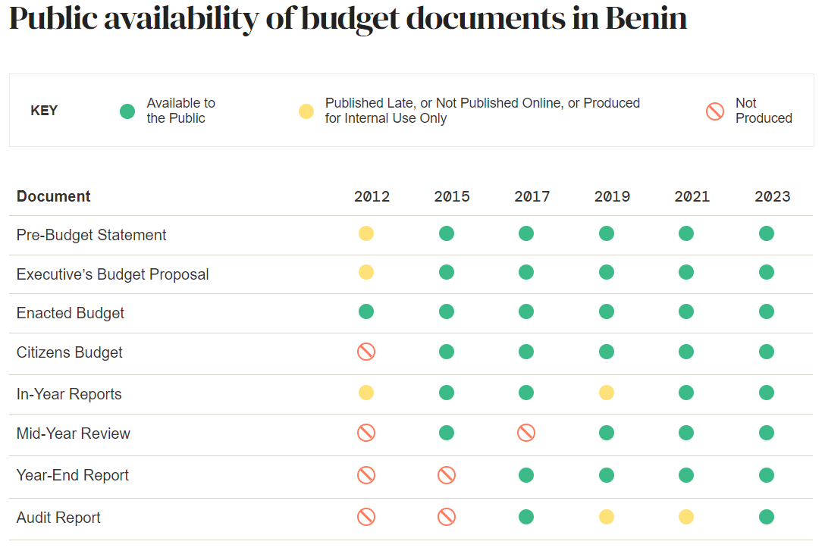
Evaluating the extent of budget transparency
The Open Budget Index (OBI) reflects the assessment of eight (8) key budget documents that should be accessible to the public during the four phases of the budget cycle (formulation, approval, execution, and audit/oversight).
The 109 OBS transparency indicators evaluate both the public availability and comprehensiveness of each document.
The OBI is scored from 0-100 via a simple average of all indicator responses, with 61 considered as minimum benchmark for “sufficient” transparency by IBP.
International Budget Partnership​

Slide 5

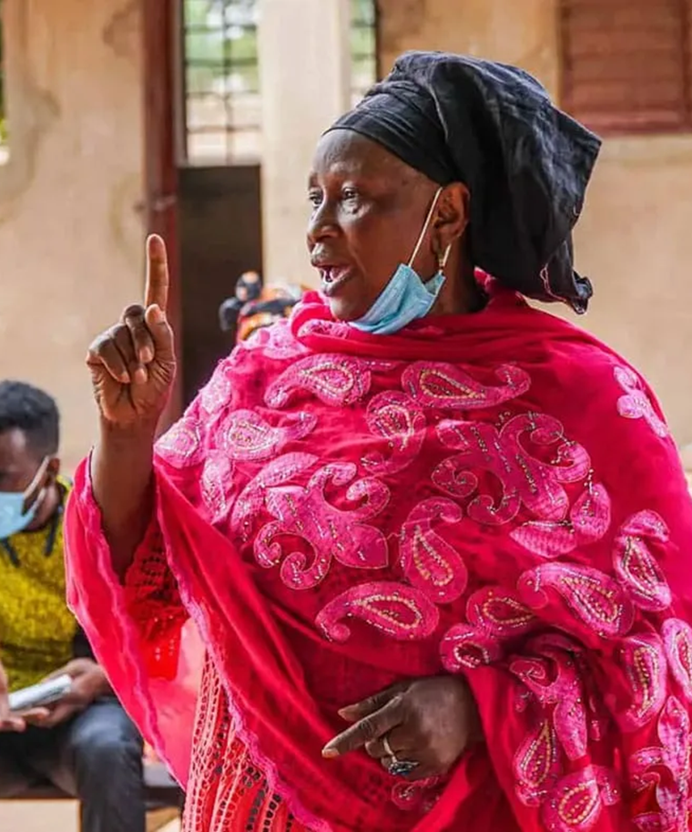
Global Findings

Slide 6
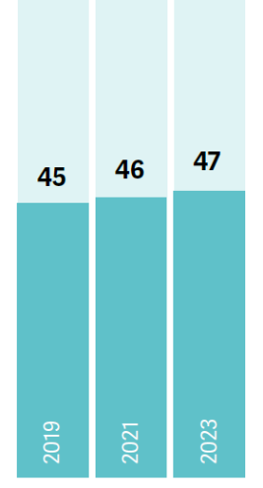
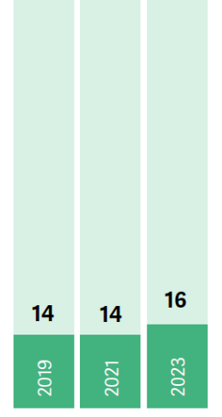
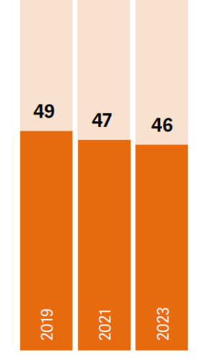
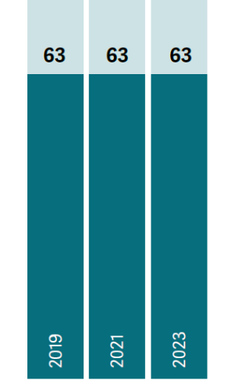
Global Average Scores, OBS 2019 – OBS 2023
Public Participation
Legislative Oversight
Audit Oversight
Transparency

Slide 7
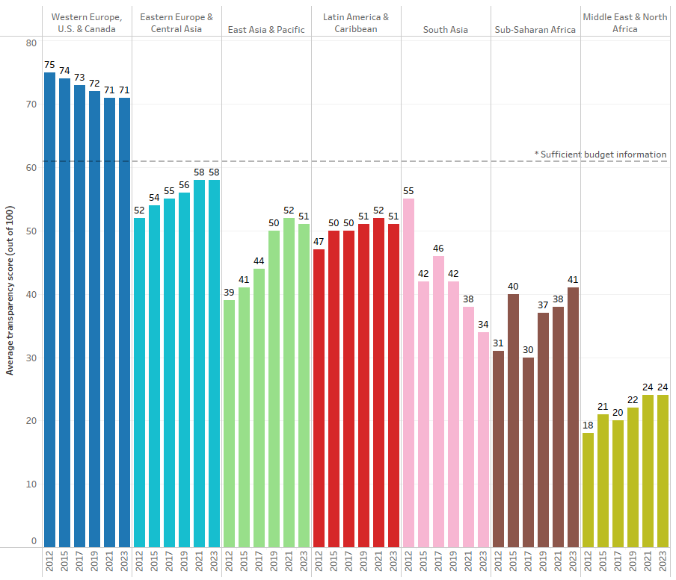
Regional trends in transparency, 2012-2023
(For 100 comparable countries assessed in OBS 2012 – OBS 2023.)
International Budget Partnership

Slide 8
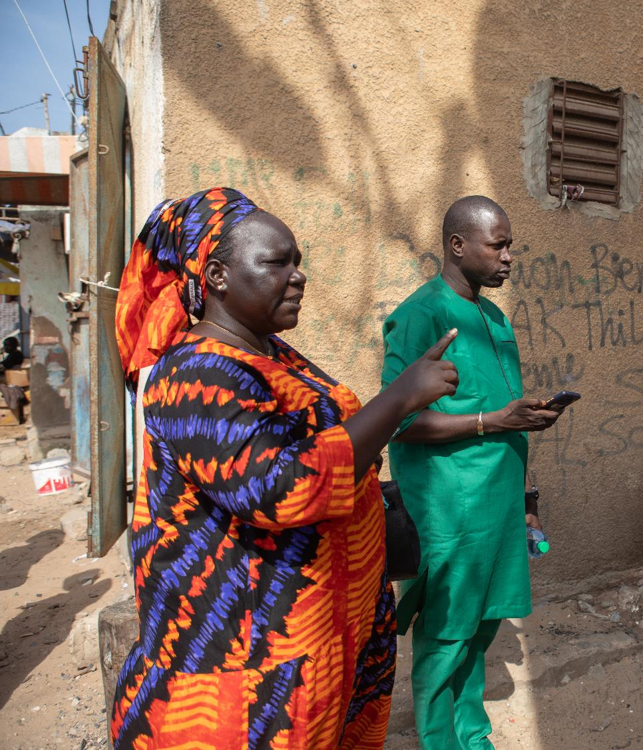
Overview of the OBS Research Process
OBS Africa Findings (45 countries assessed in 2023)

Slide 9
Africa Average Scores, OBS 2019 – OBS 2023
Public Participation
Legislative Oversight
Audit Oversight
Transparency
38
37
2019
2021
2023
2019
2021
2023
2019
2021
2023
2019
2021
2023

Slide 10
Top 10 improvers in OBS 2023 by transparency score
Top 10 African Improvers
Made substantial progress by publishing more information
+14
+10
+12
+16
+20
+12
+17
+9
+15
+12
International Budget Partnership
12

Slide 11

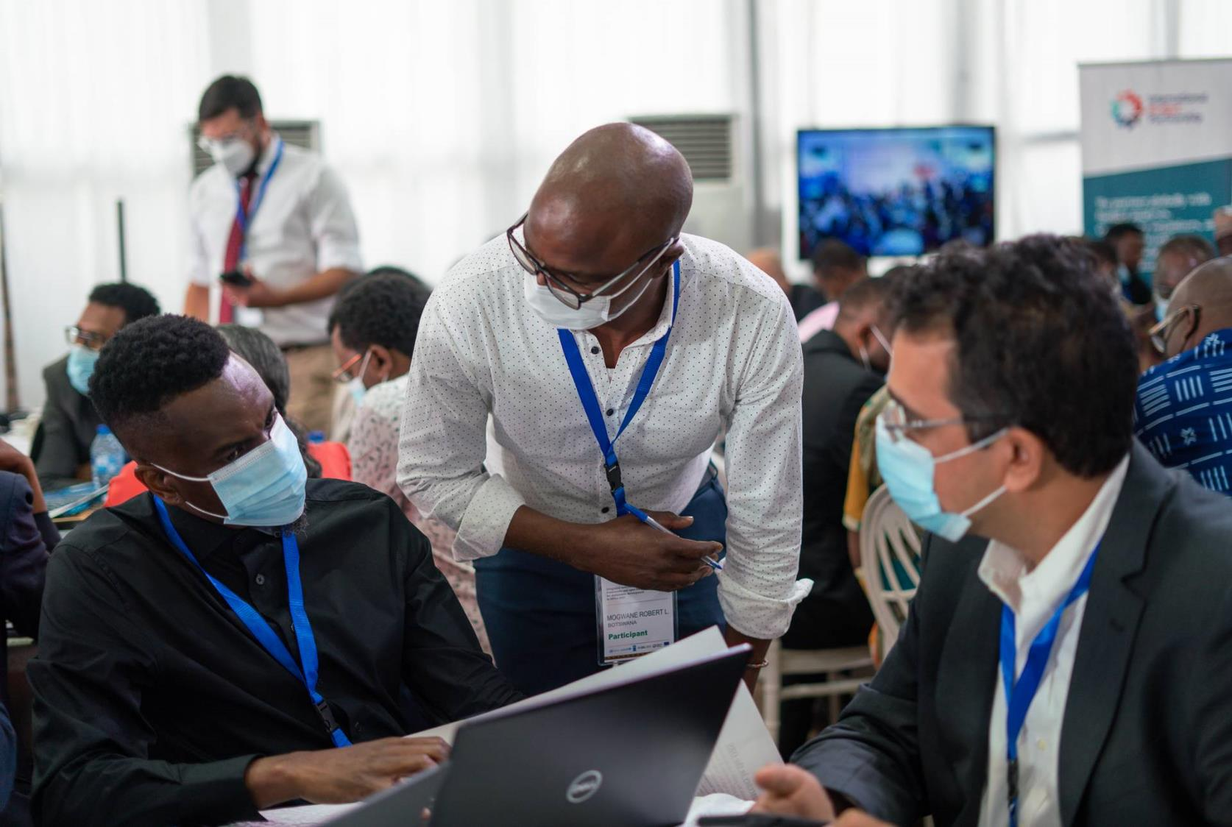
Consistency matters. Drops in publication hinder the public's understanding of flows and trust in the budget process

Slide 12
Unavailability of key budget documents in OBS 2023 for African Countries
Key budget Documents | Documents not publicly avaliable | % of documents not publicly available | Not produced | Published too late | Not published online
Pre-Budget Statement | 21 | 47% | 5 | 6 | 10
Executive’s Budget Proposal | 12 | 27% | 2 | 1 | 9
Enacted Budget | 6 | 13% | 0 | 3 | 3
Citizens Budget | 19 | 42% | 5 | 10 | 4
In-Year Reports | 25 | 56% | 4 | 14 | 7
Mid-Year Review | 29 | 64% | 24 | 2 | 3
Year-End Report | 21 | 47% | 9 | 1 | 11
Audit Report | 25 | 56% | 14 | 2 | 9
Total | 158 | %43 | 63 | 39 | 56
From 45 African countries assessed in 2023, a total of 202 out of 360 budget documents were publicly available on time and on government websites
International Budget Partnership
12

Slide 13
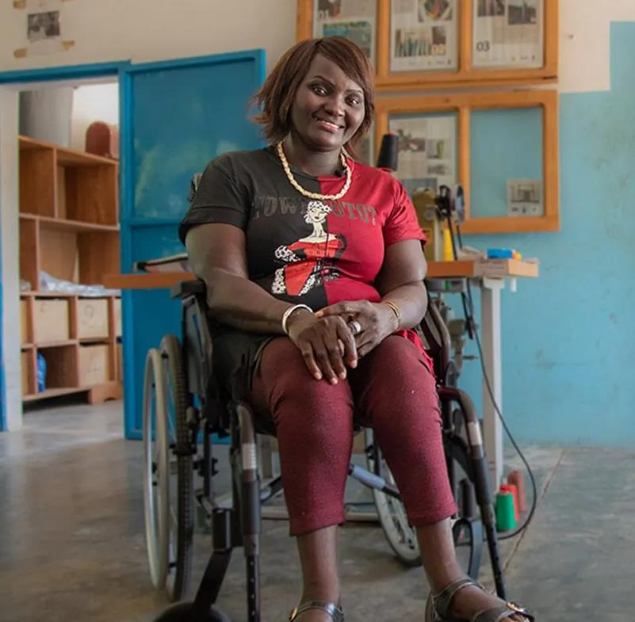
v
Critical information on debt, taxes and fiscal risk are often missing.

Slide 14
Percentage of countries in Africa presenting information on sources of revenues
Many countries in Africa fail to provide information on sources of revenue during budget execution.
60%
51%
44%
38%
29%
13%
Tax revenue
Non-Tax revenue
All revenue BY-1
All revenue
All revenue
All revenue
Executive budget proposal
In-Year Reports
Mid-year Review
Year end Report

Slide 15



In Africa, critical information on debt and fiscal risk is often missing in the budget.
73%
73%
73%
45%
33%
33%
Percentage of countries*
28%
28%
23%
8%
10%
2019
2021
2022
2019
2021
2022
2019
2021
2022
3%
Net new borrowing
Total debt burden
Whether debt is domestic or external
Data on sustainability of future finances
*Out of 40 comparable countries from 2019

Slide 16
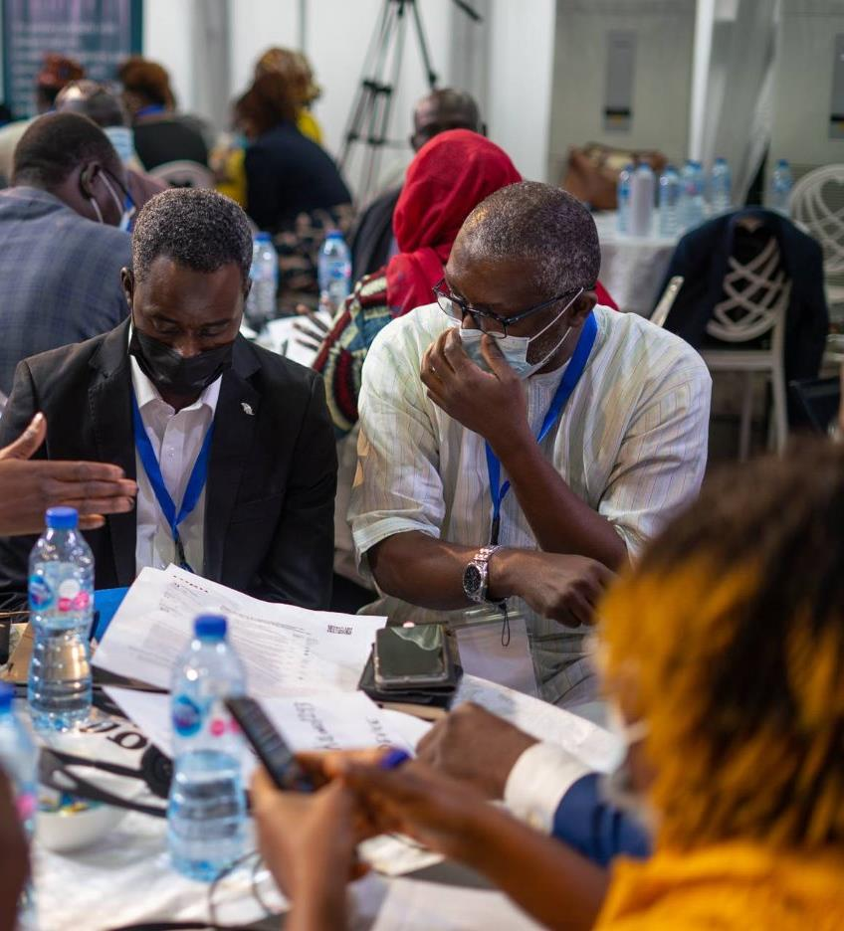
Engaging with the public is a winning proposition.

Slide 17
Despite the low global average on public participation, opportunities exist.
80%
In Africa
of countries have at least one mechanism for the public to engage with their national budget.

Slide 18




Opportunities for the public to engage with line ministries and SAIs are rare in Africa
67%
18%
42%
18%
67% of
18% of
42% of
18% of

Slide 19
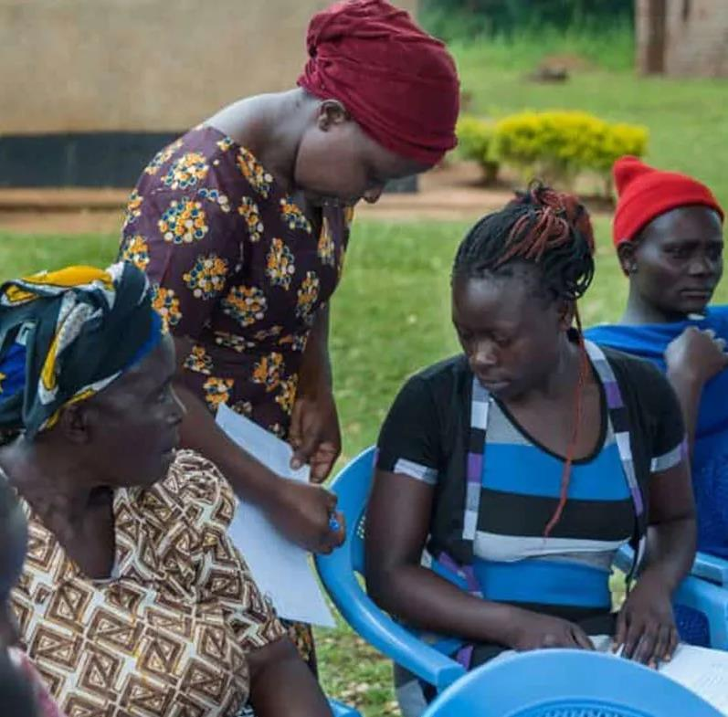
Oversight is critical in ensuring public money is spent on public interests.

Slide 20
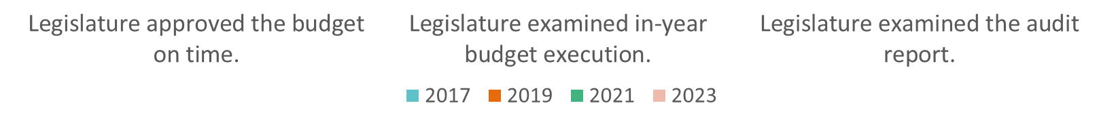
Worrying trends in legislative oversight across the budget cycle in African countries.

Slide 21
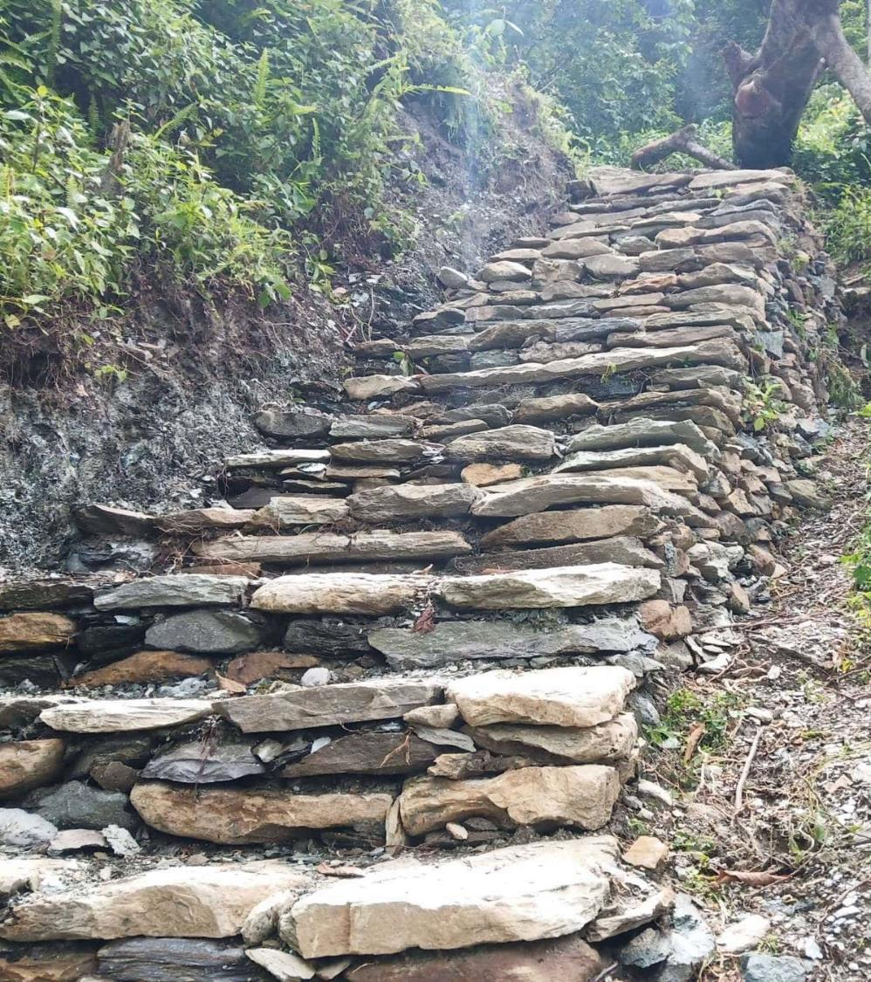
v
Progress is possible everywhere.

Slide 22
Recommendations
Governments should provide essential budget information to the public, publish what they produce, include the public in budget decisions, and institutionalize reforms.
Legislatures should provide strong and effective oversight throughout the budget cycle, while providing the public opportunities to engage.
Auditors should share audit findings with the public, work with legislatures to strengthen accountability, and invite the public into audit programming and investigations.
Donors should support reform-minded governments and civil society and identify and share key safeguards needed to prevent corruption during the next crisis.
Civil society should participate in budget decision making, collectively analyze, engage, and advocate, and focus on making budgets more accessible to all.

Slide 23

Thank You
For reviewing Country specific results, methodological note, data and individual questionnaires, please visit:
https://internationalbudget.org/open-budget-survey/

