Slide 1
Domestic Revenue Mobilisation (Integrating Local Authorities into INFF) Regional Workshop on Integrated National Financing Frameworks 2024 Public Finance for Sustainable Development in Africa by Chris P.K Conduah
Addis Ababa, Ethiopia 12-13 June 2024

Slide 2
Outline of Presentation
About INFF
Ghana’s Approach (Covid-19 Period)
Post Covid-19 Assessments
Post Covid-19 and Beyond
Observations

Slide 3
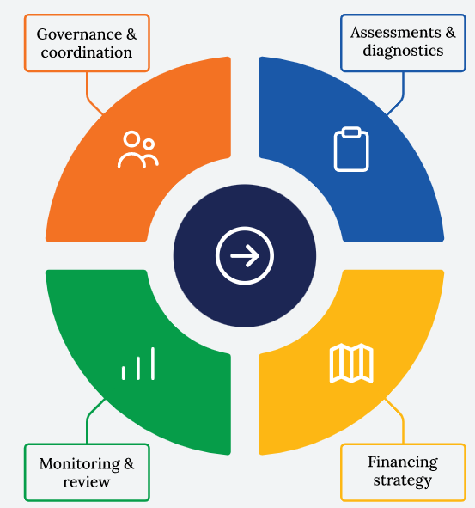
About INFF
An INFF is a tool to implement the Addis Ababa Action Agenda at the country level.
It is a tool that supports a country to manage its increasing complex financing Landscape and to mobilize additional financing to support sustainable development.
It bring together the full range of financing sources -domestic and international sources of public and private finance - and the policies that govern them

Slide 4
GHANA’s Approach
At the 2019 UN General Assembly, Ghana was one of 16 countries to commit to pioneering an integrated national financing framework (INFF).
Among these pioneers, Ghana is operationalising its INFF, building a bottom-up approach that establishes integrated financing frameworks first at the local level, called the Integrated Assembly Financing Framework.
The Outbreak of Covid-19 in 2020 created opportunities for uptake of INFF model

Slide 5
GHANA’s Approach Cont’d (Covid-19 Period)
In 2020, Covid-19 health pandemic impacted economic and social aspects of our lives.
The outbreak impacted on implementation of national, regional and District medium-term development plans, the following was carried out:
Diagnostics assessment to determine the extent of impact of Covid-19 on the metropolitan, municipal and district assemblies (MMDAs)
The assessment showed that all the assemblies were affected by the impact of Covid-19, particularly:
Development funds were reallocated to finance covid-19 expenditures
Low revenue generation as a result of lockdown of businesses and social activities

Slide 6
Ghana’s Approach Cont’d
In order to understand the impact and the extent to which it had affected economic activities, led to the development of:
Assembly Financing Framework (IAFFs) for selected Six Pilot Districts. The Pilot Districts comprise- KMA, Ketu South, Jomoro, Sefwi Wiawso, Sagnarigu and Kassena Nanakana West.
Covid-19 Recovery Plans
The methodological processes for the INFF was adopted in developing the IAFF for the Assemblies.

Slide 7
Ghana’s Approach Cont’d
The IAFF seeks to:
Better align planning and financing within the regulatory framework of revenue improvement strategies
Identify new and innovative financing solutions to finance health, education, water, infrastructure and other needs aligned to the SDGs
In partnership with the UNDP-Ghana, the outcomes, outputs and work streams to achieve the objectives were mapped out.

Slide 8
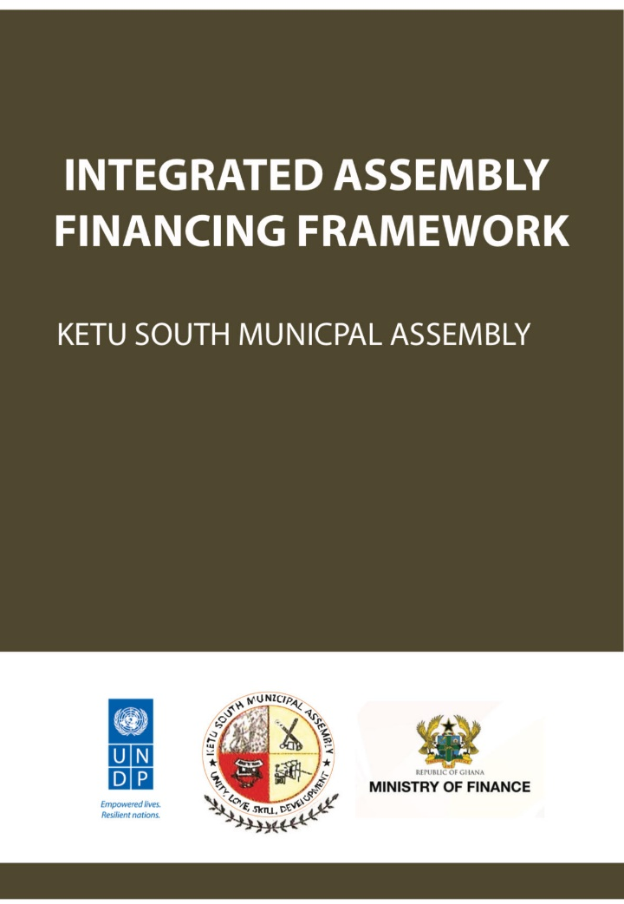
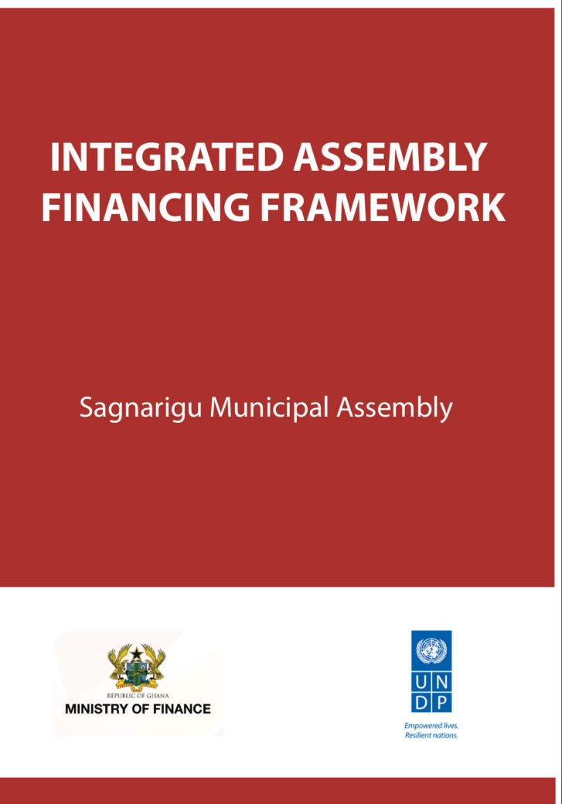
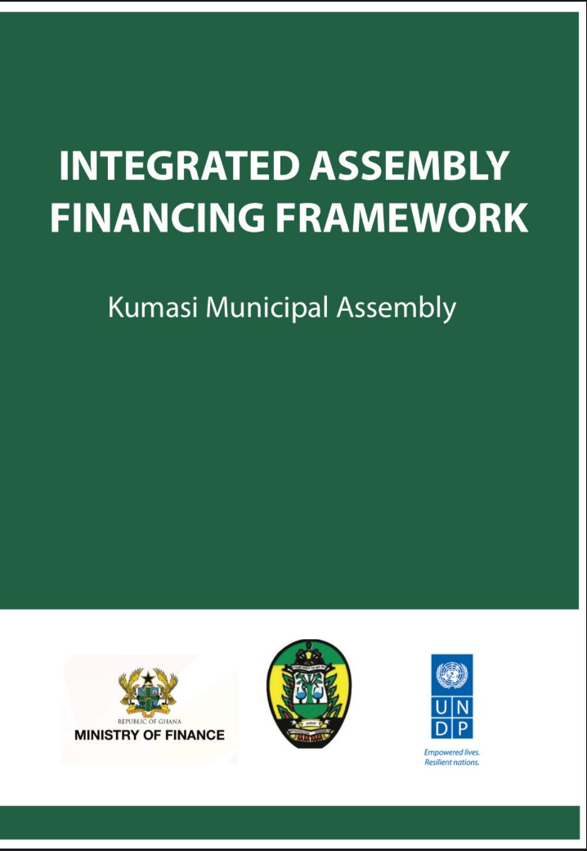
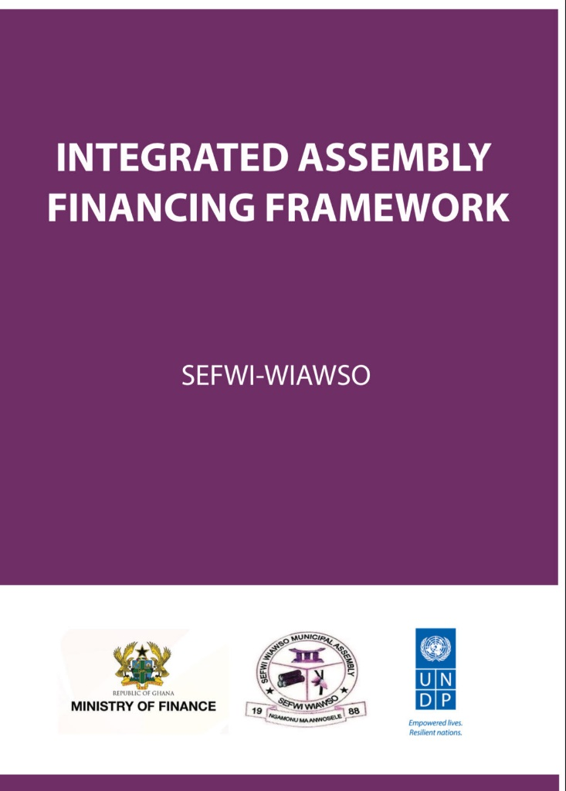
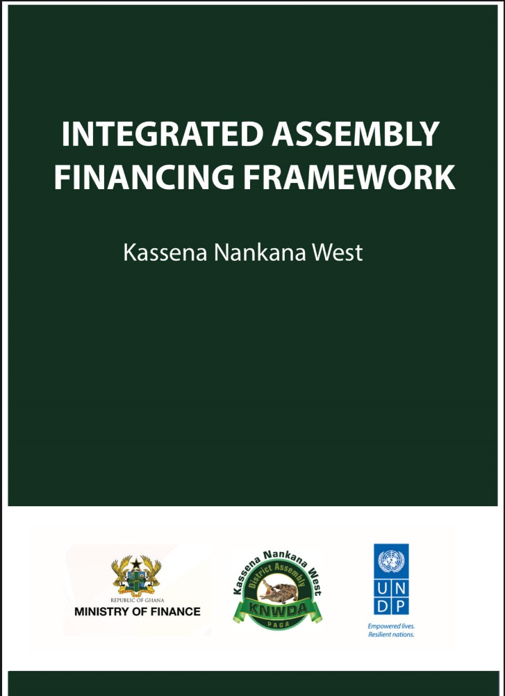

Slide 9
Post COVID-19 Assessment
2023 Assessment
Trend in MMDAs (260) IGF growth, 2017-2022
In 2023, NDPC in collaboration with UNDP-Ghana initiated process to assess implementation of IAFF and address capacity challenges.
The assessment revealved a bounce back in IGF to pre-covid-19 levels, however, below potentials of MMDAs

Slide 10
Post COVID-19 Assessment Cont’d

Slide 11
Post COVID-19 Assessment and Tax Gap Analysis

Slide 12
Post COVID-19 Assessment
Tairlor made training targeting the six MMDAs and MMDAs within the region of the pilot District.
The training modules included:
Legal Framework for local government revenue in Ghana
Revenue Improvement Action Plan (RIAP)
Roles and Responsibilities of Duty Bearers
Sustainable Financing (explored diverse funding options like diaspora funding, public-private partnerships (PPPs), Green/Climate ﬁnance, philanthropy, and designing bankable projects)

Slide 13
Post COVID-19 Assessment
84 Officers from the MMDAs Trained
Scaled up training of over 600 personnel from the MMDAs benefited from these capacity-building endeavours, equipping them to optimize revenue collection and enhance compliance.
The National Development Planning Commission coordinated the process made up of Ministry of Local Government and Rural Development, and Ministry of Finance, Institute of Local Government Studies, Local Government Service in partnership with UNDP.
Data collection ongoing to determine improvement in domestic revenue mobilization for the selected MMDAs

Slide 14
Post Covid-19 and beyond
Efforts are geared towards linking investment strategies to domestic revenue mobilisation.
The assignment focuses on 8 MMDAs in Northern part of Ghana due to their unique challenges with conflict.
NDPC is currently coordinating a toolkit development process with funding from the UN Peacebuilding Fund and in collaboration with the UGBS, Institute of Local Government Studies, University for Business and Integrated Development Studies-Upper West, Ghana Investment Promotion Center and Ministry of Local Government, Decentralisation and Rural Development.
The Assemblies will be required to develop investment attraction strategies based on their potentials to improve DRM.

Slide 15
Key Observations
A gradual shift from administrative focused assemblies to enterprenuerial focus (Deepened interface between Assembly and Private sector)
Collaboration with key institutions creates awareness about ongoing interventions and eliminates duplication.
Intensification of building among collaborating institutions- learning by doing as opposed to use of consultants
Perioding monitoring of MMDAs – the “big-brother” concept

Slide 16
Conclusion
The IAFF implementation using the INFF methodological approach was successful at the local level
The Selected MMDAs have developed and updated their Revenue Improvement Plans based on the targeted training modules
There is the need to intensify monitoring and evaluation to assess results and redirect MMDAs
More efforts are needed to scale up training module and toolkit on investment strategies across all 261 MMDAs in Ghana
IAFF and investment attraction for revenue mobilization will be mainstreamed into planning guidelines for 2026-2029 planning period

Slide 17

Thank You

