Slide 1
Dealing with Current Global Economic Challenges Egypt Experience Regional Workshop on Integrated National Financing Frameworks 2024 Public Finance for Sustainable Development in Africa by Dr. Mohammed Ibrahim Abdu (PhD) Associate Minister of Finance for Policies and Economic Affairs
Addis Ababa, Ethiopia 12-13 June 2024

Slide 2
Economic Challenges

Slide 3
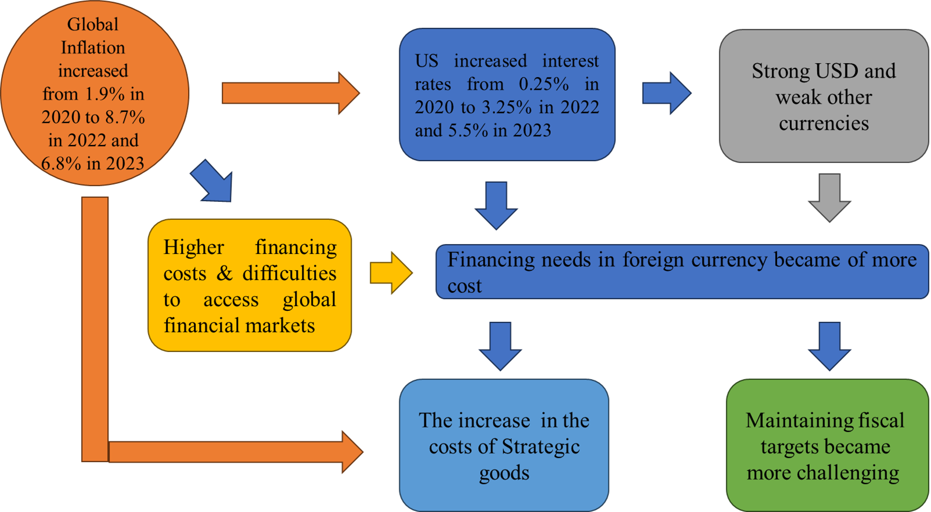
The Global Economic Challenges:

Slide 4
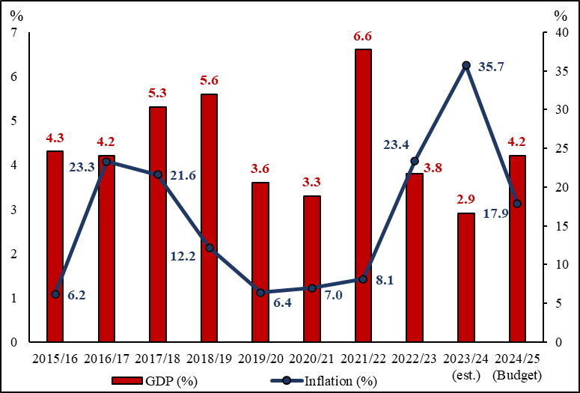
The Global Economic Challenges’ Impact on Egypt:
1- Russia & Ukraine
2- The War in Gaza
3-Tensions in the Red Sea
Egypt was one of the few emerging market countries that experienced a positive growth rate in 2020. As a result of the government’s swift and prudent policy response, coupled with IMF support.
COVID -19
Macroeconomic conditions since the approval of the program have been challenging, with rising inflation, foreign exchange shortages, and elevated debt levels and financing needs.
The difficult external environment generated by Russia & Ukraine war was subsequently aggravated by the conflict in Gaza, as well as tensions in the Red Sea. These developments increased the complexity of macroeconomic challenges and called for decisive domestic policy action supported by a more robust external financing package, including from the IMF.

Slide 5
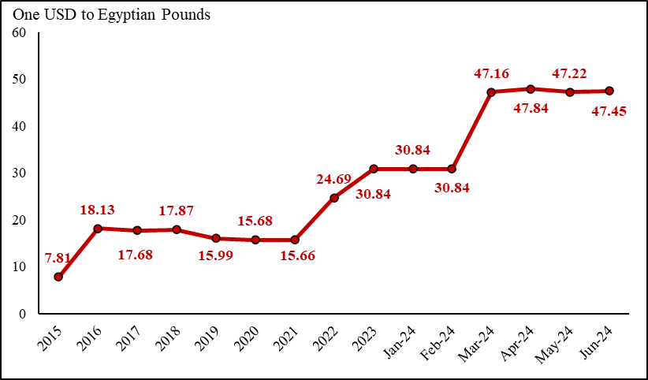
The Global Economic Challenges’ Impact on Egypt:
3 November 2016: The Egyptian Pound devalued as part of a $12 billion loan agreement with the IMF. The pound lost 56.9 percent of its value by the end of November 2016.
21 March 2022: One month after the Russia-Ukraine war started the CBE devalued the Egyptian pound by 36.5 percent.
In January 2023, Egypt depreciated its currency, resulting in a decline of 19.9 percent in the currency's value.
6 March 2024: the Central Bank of Egypt (CBE) took the long-awaited decision to float the pound. The move was among the conditions set by the International Monetary Fund (IMF) before it agreed to advance a new bailout loan of $8 billion. The currency lost 34.6 percent of its value.
06 March 2024
21 March 2022
3 November 2016
January 2023
Currency Appreciation

Slide 6
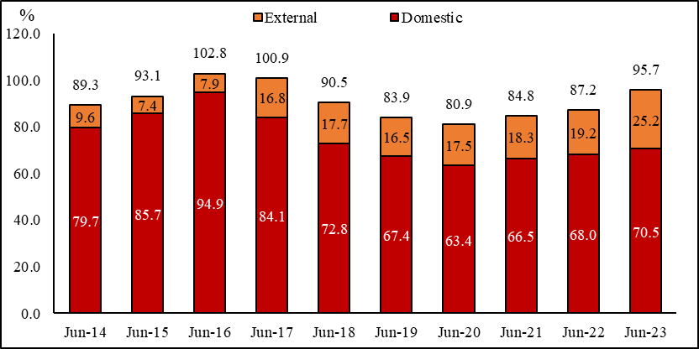
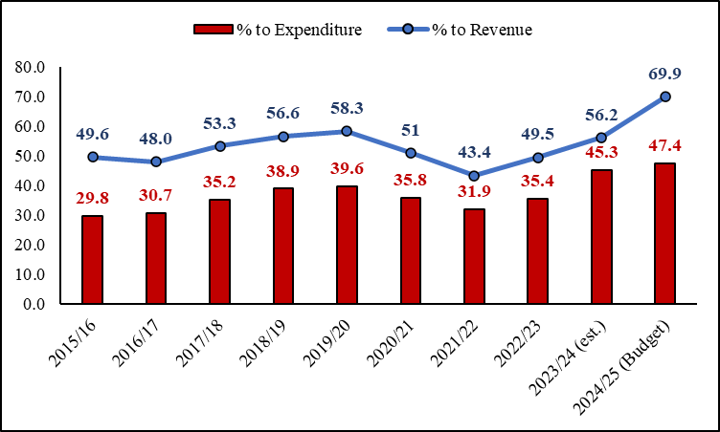
The Global Economic Challenges’ Impact on Egypt:
The Arab Spring
2016 Economic Reform Program
Current Challenges
Interest Payments

Slide 7
The IMF Program & Supporting Packages

Slide 8
IMF Executive Board Approval, Augmentation of Financing:
On the 29th of March, The IMF Executive Board completed the First and Second Reviews of the Extended Fund Facility (EFF) for Egypt and approved an augmentation of the original program by about US$5 billion to reach $8.0 billion, in addition to having access to $1.2 billion from the RST. The approval allows Egypt to draw the equivalent of about US$820 million in April 2024, as an upcoming tranche.
2024
Next Review will be in June-July 2024: Discussions on outturns of March indicators will take place, with SLA/Board expected in July 2024, followed closely by the release of the 3rd tranche.
The following review will be in September-October 2024: Discussions on outturns of FY 2023/24 indicators will take place, with SLA/Board expected in October 2024, followed closely by the release of the 4th tranche.
Reviews with the IMF will then take place semi-annually, with respective tranches disbursed after said reviews are done and SLA is reached.

Slide 9
Key Pillars of the IMF program:
Three Key Pillars
Moving to a durably flexible exchange rate regime while prioritizing the primary goal of achieving price stability & building up sustainable adequate levels of foreign exchange reserves.
Continued fiscal consolidation to put government debt to GDP and gross financing needs on a firm downward path over the medium term.
Broadening and deepening structural and governance reforms to unleash high, job-rich, and sustainable private sector-led growth paths including reducing the state footprint and announcing state ownership policy, adopting a more robust competition framework, enhancing transparency, and ensuring improved trade facilitation.

Slide 10


Ras El-Hikma Deal with UAE ($ 35 Billion):
The largest FDI deal in Egypt’s history was secured on the 23rd of February 2024 worth $35.0 billion.
The inflows of the deal were split between two tranches:
The first tranche ($15.0 billion) has been disbursed with $10.0 billion in fresh money (received already by CBE during the first week of March 2024), and $5.0 billion in UAE deposits, converted into FDI.
The second tranche ($20.0 billion) was received by the middle of May 2024, with $14.0 billion in fresh money and $6.0 billion remaining from the UAE deposits, converted into FDI.
The Ministry of Finance will receive 50% of the fresh money amounting to $12.0 billion (an average of EGP 540 billion, or 4.4% of total debt). The money is expected to be received by the treasury during FY2023/2024 and will help improve debt indicators (i.e., expand on the revenue base of the government) as well as, lower our forecasted interest payments for the coming years.
This deal is separate from the main asset sales program which the government is committed to continuing as part of the structural reform program in place, to have greater private sector participation and improve fiscal indicators

Slide 11




EU-Egypt: A Strategic and Comprehensive Partnership Era:
A financing package worth EUR 7.4 billion has been signed between the EU and the Arabic Republic of Egypt.
This “financial and investment support” package has a timeline of three years – concurrent with the IMF program – from 2024 to 2027. It includes the following amounts and areas of focus:
EUR 5.0 billion in concessional loans under the “Macro-Financial Assistance” Pillar.
EUR 1.8 billion in additional investments, under the Southern Neighbourhood Economic and Investment Plan.
EUR 600 million in grants, including EUR 200 million for migration management.

Slide 12
The Economic Reform Program

Slide 13
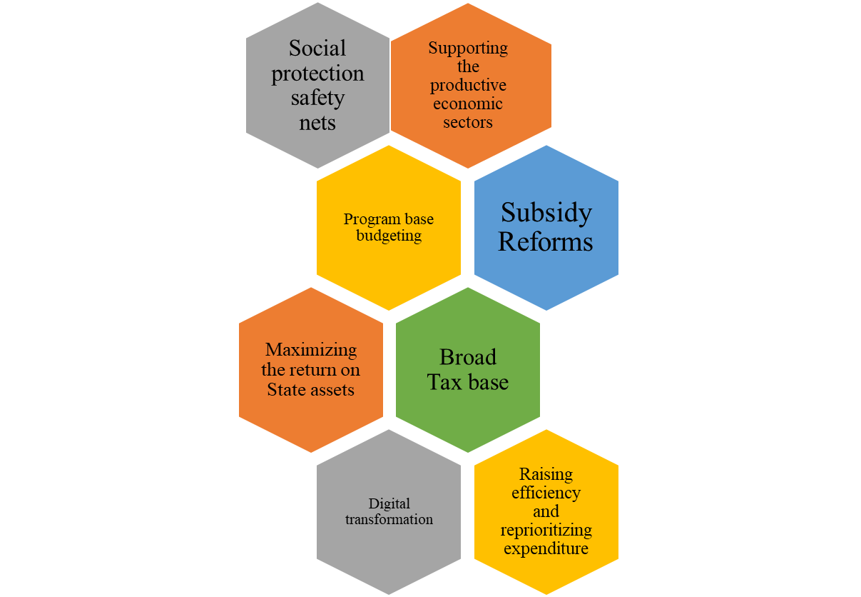
Fiscal & Structural Reforms
Ministry of Finance is implementing a comprehensive structural financial reform plan to maintain macroeconomic stability, control public finances, and promote a strong and inclusive economic growth path led by the private sector.

Slide 14



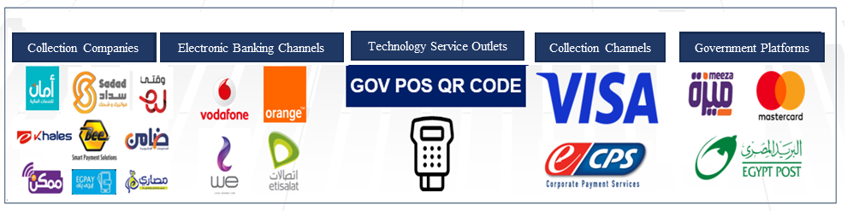

Automation of Public Finance Management:
Closing 61,000 accounts of government agencies and transferring these accounts to one account at the Central Bank, “The Treasury Single Account.”
The automation of the (GPS) electronic payment system for all accounting units (2,637 units) has been completed by 100%.
The budget is prepared, implemented, and closed, and final reports are issued in a completely automated manner.
The budget of 52 economic authorities has been automated on the (GFMIS) system.
Electronic Payment and Collection Center

Slide 15


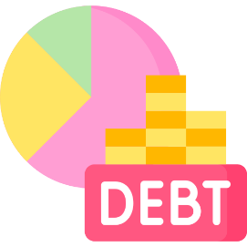
Using the General Government Indicators as the Main Fiscal Indicators:
Consolidating the principle of comprehensiveness and unification of the state’s general budget and presenting the state’s public financial data in a more accurate and comprehensive manner that is consistent with the generally accepted statistical rules and foundations for publishing financial data and indicators for different countries.
Including the revenues and expenditures of economic authorities (59) into the revenues and expenditures of the state’s general budget to be consistent with the actual reality of economic activity in Egypt, while creating the necessary regulatory and legislative mechanisms to implement this proposal.
Supporting the State’s main goal of controlling public debt, by introducing a debt ceiling that encompasses all general government entities and gives an accurate view of the country’s debt levels.
IPO
Egypt’s IPO program is a list of 35 state-owned companies that are offered to strategic investors, the public offering on the Egyptian Stock Exchange, or both, to provide foreign currency, within the framework of a state-owned policy document.

Slide 16









Continuing to Reform the Structure of Public Spending:
Control the increase in wages and salaries, while securing an annual increase in civil servant incomes exceeding the average inflation rates.
Continue the gradual shift to cash and semi-cash subsidies and direct the subsidy to the most vulnerable groups.
Reform the bread subsidy system and take measures to rationalize consumption and improve production efficiency.
Implement a plan to gradually lift fuel and electricity subsidies until the end of 2025.
Implement initiatives targeting specific production and services sectors.
Increase the pensions to cope with inflation and continue the expansion of social protection networks including "Takaful and Karama" programs.
Comply with the constitutional entitlement to spending on health and education. (3% and 4% of the GNI respectively)

Slide 17
Diversifying and Extending Debt Maturity:
Reducing the cost of financing while reducing inflation rates, continuing to achieve a primary surplus, and reducing the budget deficit.
Increasing the private sector’s contribution to financing public investments and development financing, in addition to public and government investments.
102.8%
2015/2016
Reduction
95.7%
2022/2023
Target
80%
2025/2026
Diversifying Sources of funding
Type
Ordinary
Islamic
Tools
Bonds
Green / Sustainable
Sukuk
Loans
Diversifying Markets
International
USD $
€ Euro
¥ Yen
Local
Regional
Yuan 元
Extending the Average Debt Maturity
2.1 Year
June 2016
3.2 Year
June 2023
5.0 Year
June 2027

Slide 18
Reforming and Developing the Egyptian tax system:
The Ministry of Finance is working to carry out structural reforms and implement several development projects in the income and value-added tax system by re-engineering procedures on three main axes:
Redesigning tax policies to meet the requirements of global development and market needs which contributes to increasing revenues and expanding the tax base.
Reforming tax administration to curb corruption, evasion, and tax avoidance in addition to working to limit the informal sector and increasing voluntary tax compliance.
Reviewing and updating current international agreements to ensure closing the loopholes used to bypass taxes and transfer profits and adopting global best practices in the digital economy field (commerce and digital services).
Tax Policy
Tax Policy Development Pillars
Tax Administration
International Taxation

Slide 19




Tax Reform - Digital Transformation Projects:
Automation of the main tax processes:
The project also aims to provide an electronic portal for the taxpayer to facilitate all tax transactions and digitize all tax files to ensure the speed and accuracy of results.
E-Invoice (B2B):
The project aims to establish a central system for electronic billing for real-time receipt, review, and approval of invoices.
E-Receipt (B2C):
The electronic receipt project and the electronic invoice project represent an integrated system for corporate transactions with ordinary consumers (B2C).
Government Payroll Automation System:
An automated system for the preparation and management of salaries and benefits for all civil servant employees.

Slide 20
Fiscal Targets

Slide 21
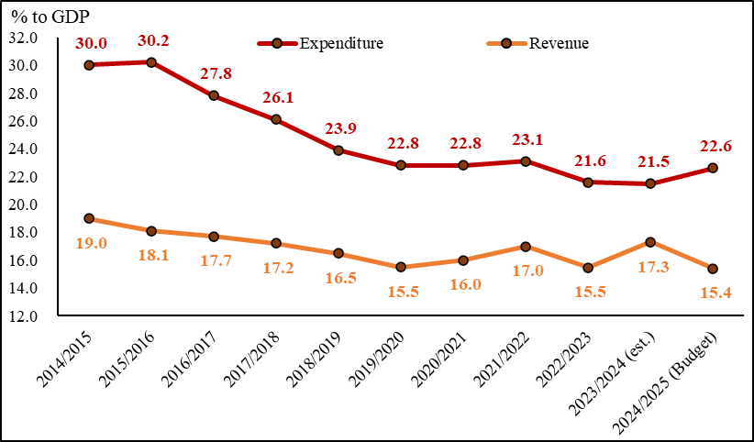
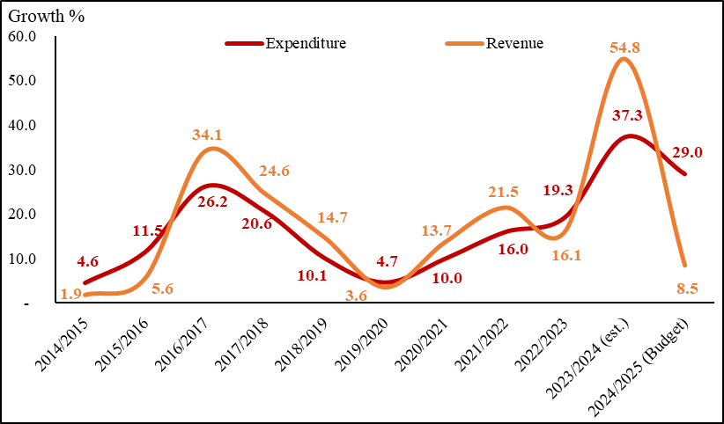
Development of Revenues and Expenditure:
11
7.3

Slide 22
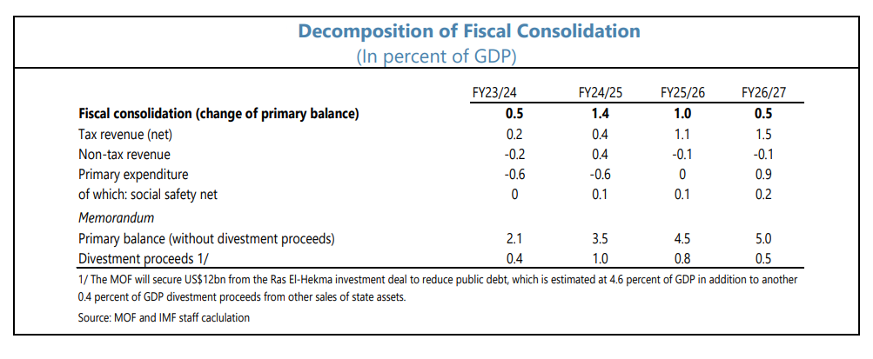
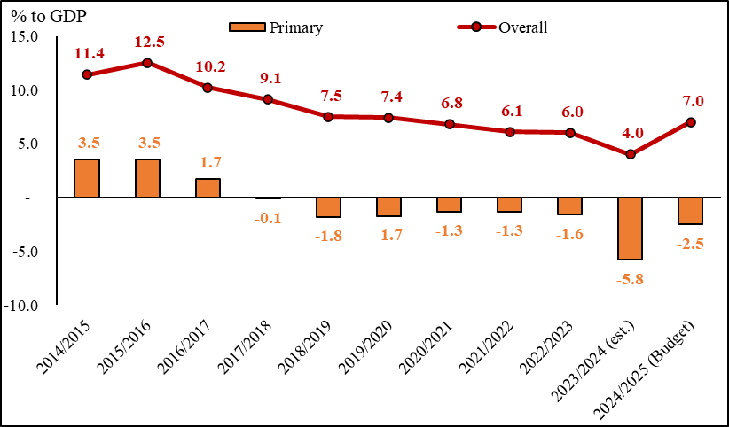
Fiscal Consolidation:

Slide 23
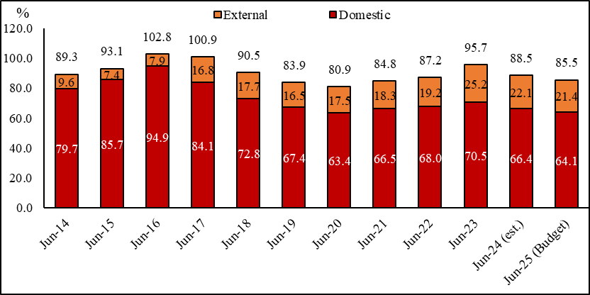
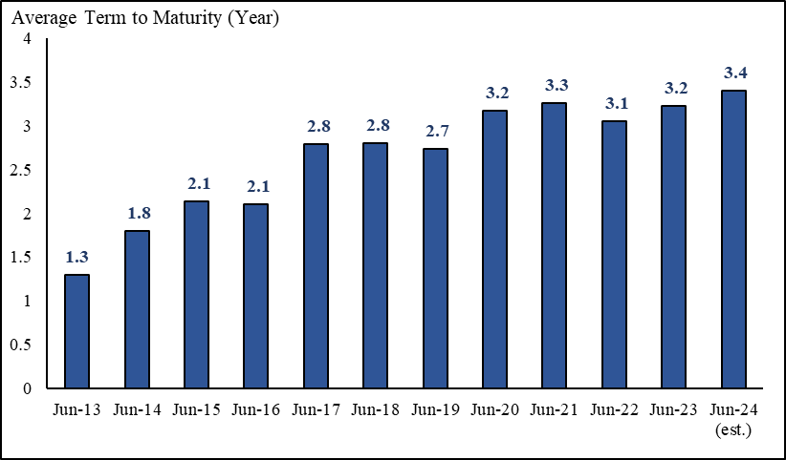
Debt Projections:

Slide 24

Thank You

