Slide 1

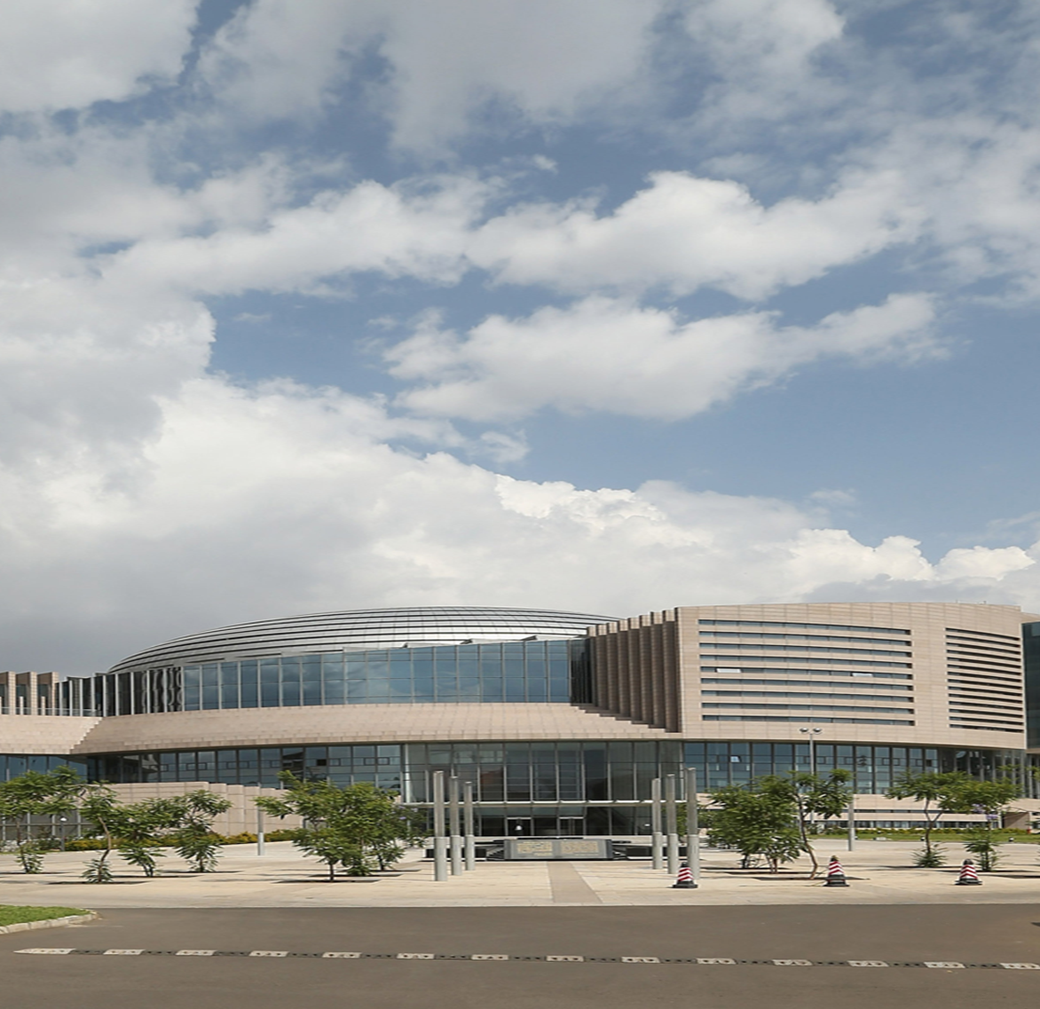

African Regional Workshop on Integrated National Financing Frameworks 2024 Public Finance for Sustainable Development in Africa
Rumbidzai Treddah Manhando
Programme Coordinator, African Union Financial Institutions, African Union Commission
12 June 2024

Slide 2






Presentation Outline
II Opportunities for Africa
IV. Areas AUC envision to support countries in future
III. AUC Support towards INFFs related areas in Africa
V. Conclusion
I. Introduction

Slide 3
Introduction: Economic Context
Public Debt
Africa’s Growth
Public debt in Africa has increased significantly over the last decade, increasing by about 35 percentage points to 65 percent of GDP in 2024 (USD1.152 trillion) from 28.8 percent of GDP (USD425.8 billion) in 2012
Africa’s average growth is projected to rise to 3.7 per cent in 2024 and 4.3 per cent in 2025, surpassing the projected global average of 3.2 percent
Domestic Resources Mobilisation
Foreign Direct Investment
Average tax-to-GDP ratio remains 15.1%
Illicit Financial Flows estimated at US$89 billion
Global foreign direct investment declined by 12% in 2022, following a strong rebound in 2021 and in 2023, Africa's FDI flows remained nearly unchanged at an estimated $48 billion, marking a slight 1% decrease compared to the previous year

Slide 4

Opportunities for Africa
Supporting infrastructure development projects
The African Union plays a crucial role in supporting various infrastructure development projects across the continent, contributing to economic growth and regional integration
Supporting Inclusive Growth and Sustainable Development
The African continent should sustain growth of 7-10 percent to achieve continental goals
Facilitating trade and investment initiatives
Facilitating trade and investment initiatives under the African Continental Free Trade Area to enhance economic cooperation among member states, promoting sustainable development and poverty reduction.
Promoting sustainable financial mechanisms
Promoting sustainable financial mechanisms to ensure effective resource mobilization for development projects, supporting the achievement of national financing frameworks.

Slide 5


AUC Support towards INFFs related areas in Africa
Framework on key actions to achieve inclusive growth and sustainable development in Africa
Achieving high and inclusive growth and sustainable development in Africa requires a different and strategic approach to policy making to position the continent as a new growth pole.
Domestic Resource mobilisation
Strengthening the fight against illicit financial flows and support towards bolstering tax administrations. Mobilizing adequate domestic resources is essential in the implementation of Integrated National Financing Frameworks and national development plans.
Promotion of Investment
The establishment of the African Virtual Investment Platform will be instrumental in fostering sustainable investments critical for in Integrated National Financing Frameworks
Reform of the global financial architecture and international tax
Reliance on external aid and funding can create vulnerabilities in national financing, affecting the sustainability of development initiatives outlined in Integrated National Financing Frameworks. The reform of the international financial architecture can assist in bridging the funding gaps

Slide 6
Areas AUC envision to support countries in future
Strengthen harmonizing national and regional financial policies
01
02
Enhance coordination among stakeholders
Support countries in improving transparency and accountability
Realisation of Agenda 2063 and Agenda 2030
03
04
foster digital financial innovations

Slide 7

Thank You • شكرا • Merci • Obrigado

